Slide 2
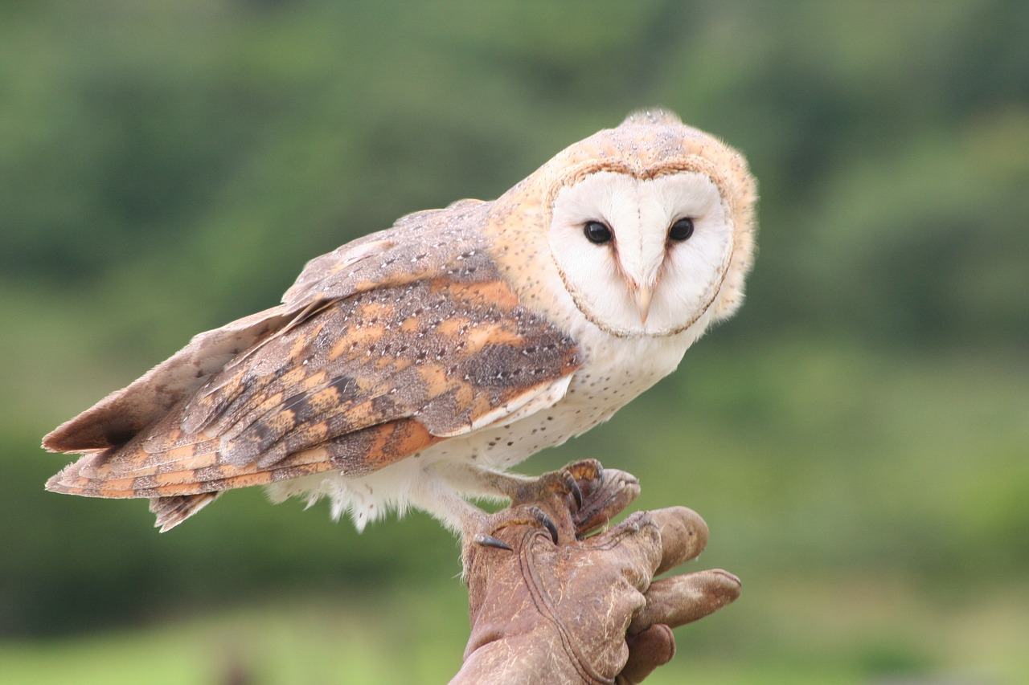
Barn Owl

Slide 3
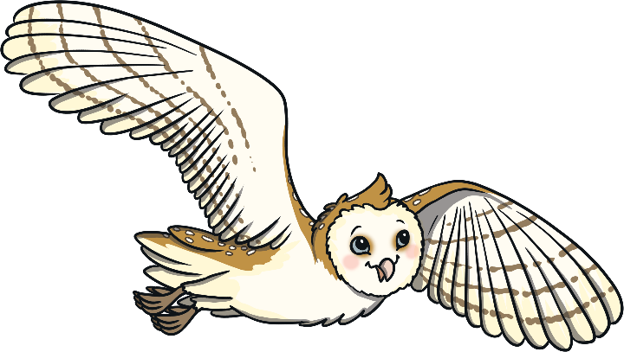
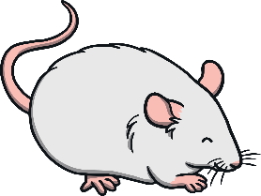
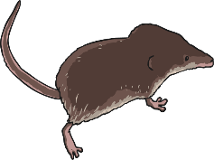
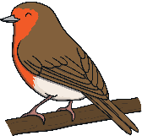
Barn Owl
Barn owls are nocturnal. They hunt at night.
They can turn their heads right around to look behind them!
They are carnivores. They eat small animals like mice, shrews and birds.
excellent hearing to find small animals in the dark
good eyesight to help them hunt in the dark
heart-shaped
face
brown feathers on the back
white feathers
on the belly
long legs for reaching into long grass to catch food
sharp talons for catching prey

Slide 4
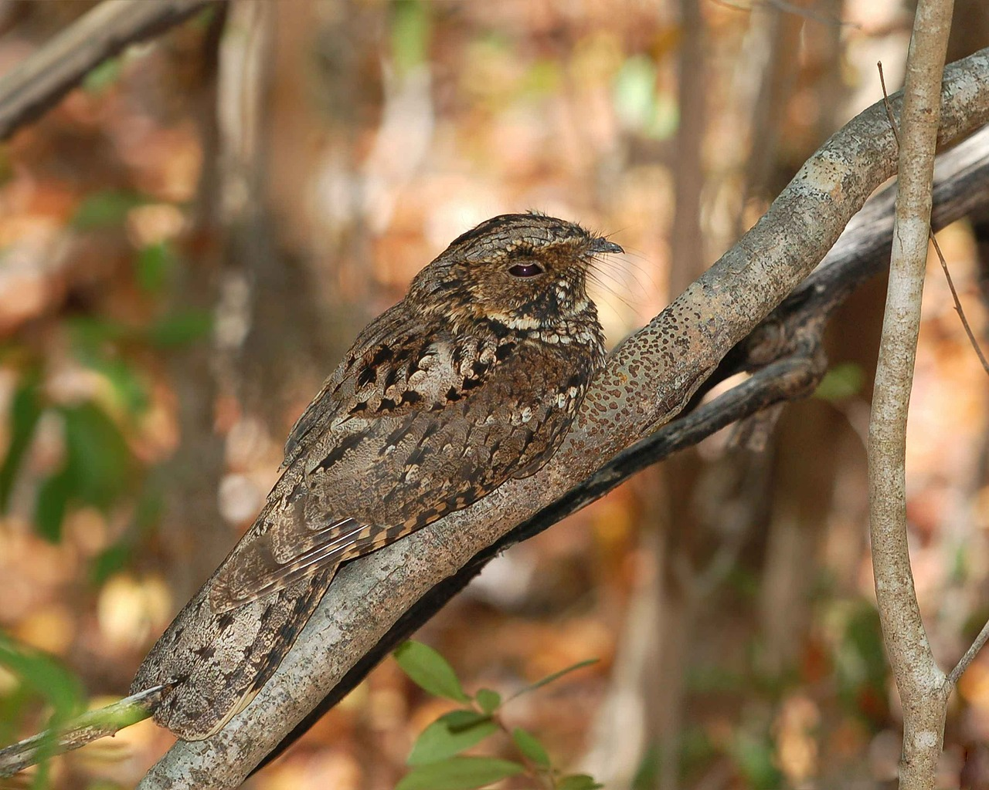
Nightjar

Slide 5
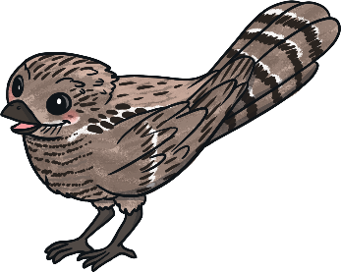
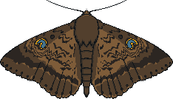
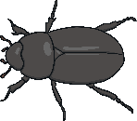
Nightjar
brown and grey feathers that blend in with tree trunks
Nightjars are nocturnal. They like to come out at dusk and dawn.
Their feathers look like tree bark. This acts as camouflage to help them hide from predators.
They are carnivores and like to eat insects, such as moths and beetles.
short beak and wide mouth, perfect for catching moths
short legs, which make walking tricky

Slide 6
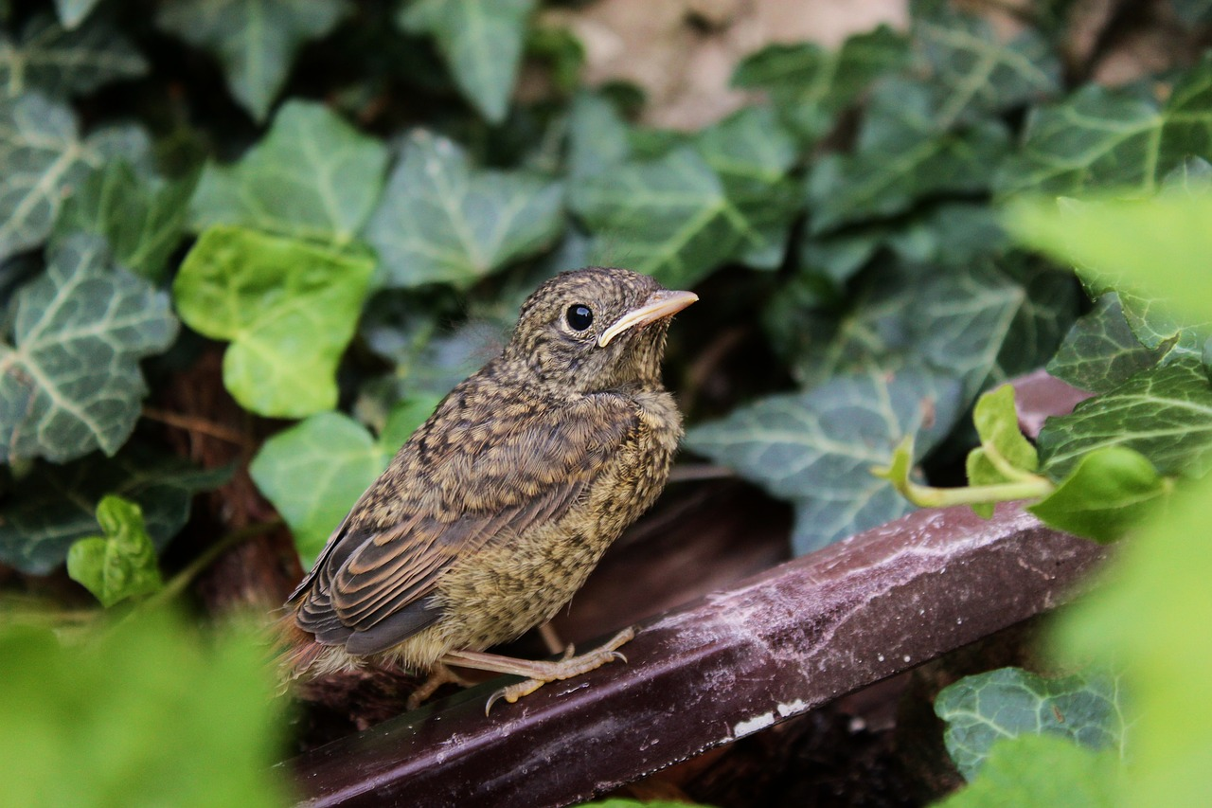
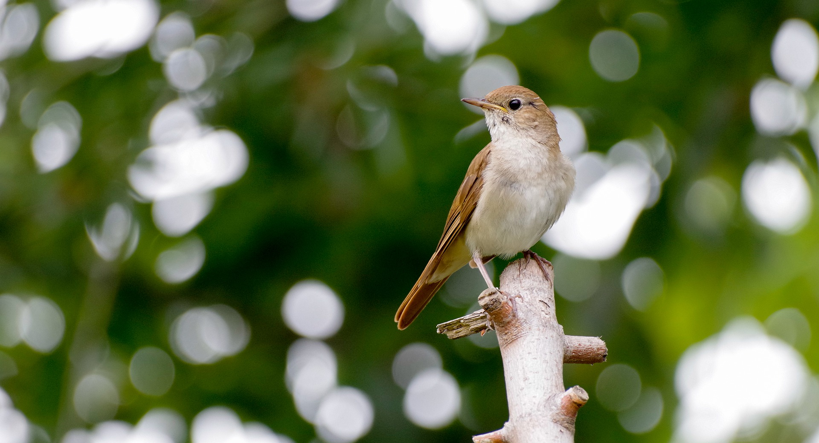
Nightingale

Slide 7
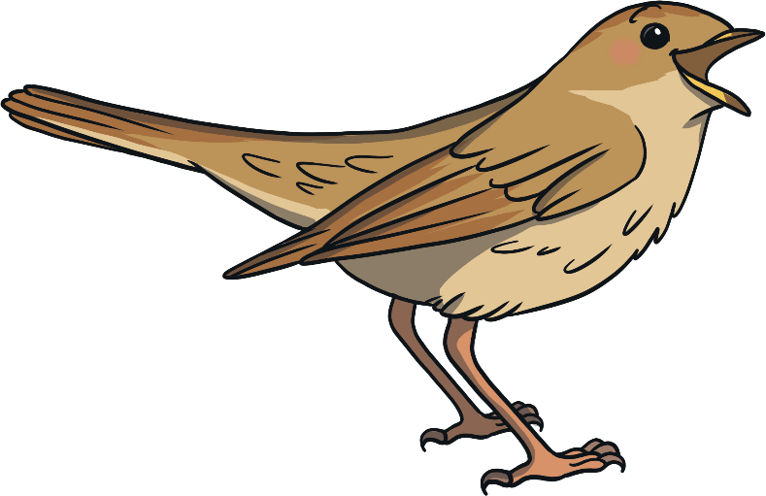
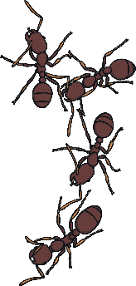
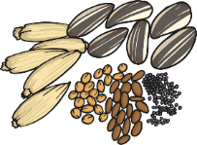
Nightingale
Nightingales are small brown birds.
They are nocturnal and their beautiful singing can be heard at night.
They are omnivores. They eat insects, such as ants and beetles. They also eat nuts and seeds.
plain brown feathers so they can hide in bushes easily
thin beak
beautiful singing voice
small body

Slide 8
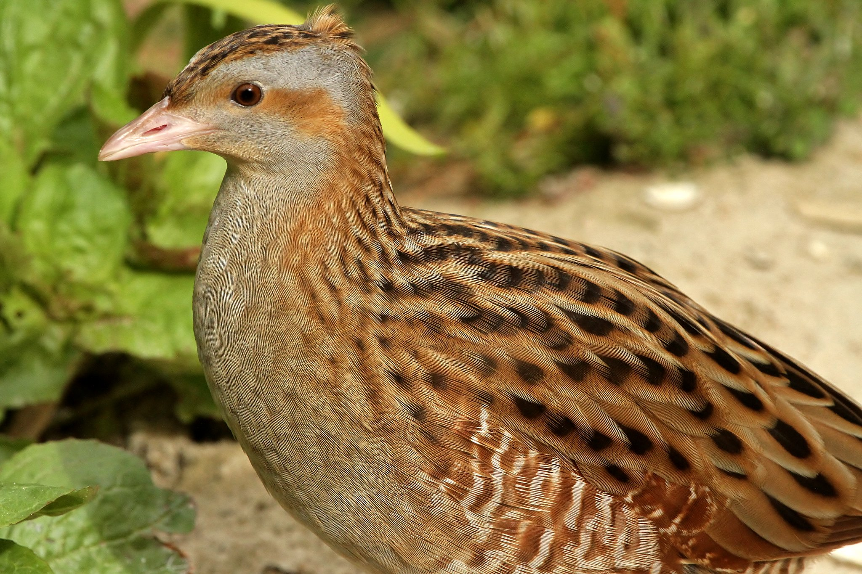
Corncrake

Slide 9
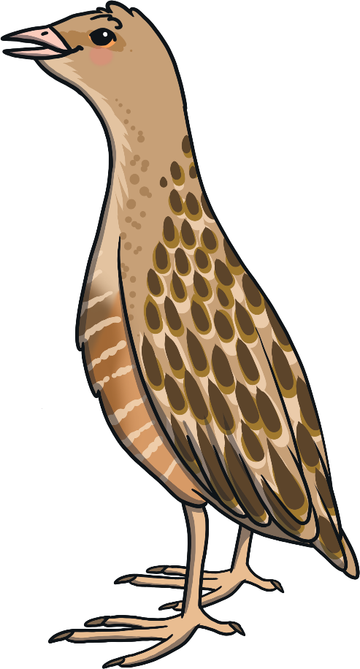

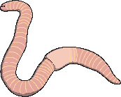
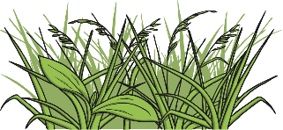
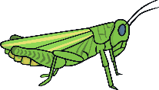
Corncrake
Corncrakes like to hide in tall grass.
They hunt at night but are hard to spot.
Corncrakes are omnivores. They eat plants, like grass. They also eat animals, such as insects, slugs and worms.
long neck
round body
long legs for wading in wetlands

Slide 10
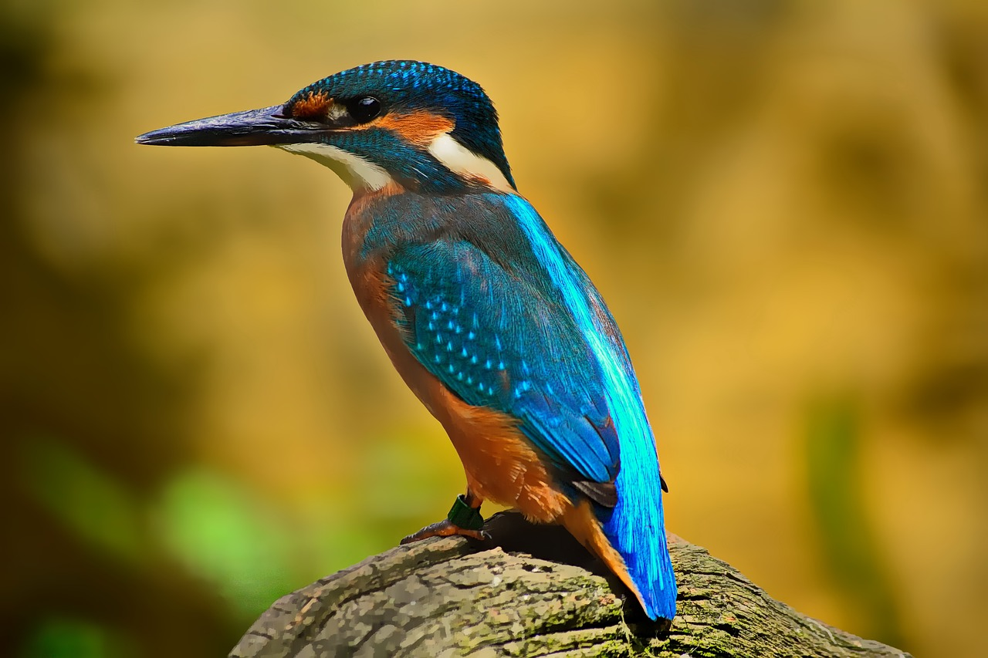
Kingfisher

Slide 11
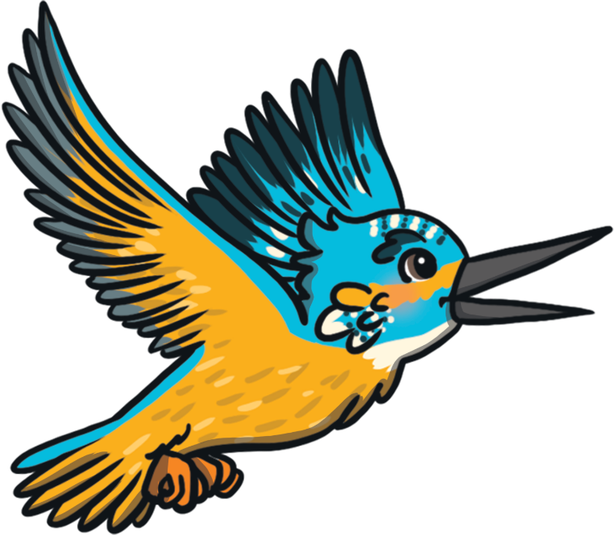

Kingfisher
Kingfishers come out during the day. They are diurnal.
They can be found fishing in rivers and lakes. They like to perch on a branch and dive down to catch their prey.
They eat small fish, like minnows or sticklebacks. They also eat tadpoles.
very bright blue and orange feathers
long pointy beak for diving into water
small body
short orange legs

Slide 12
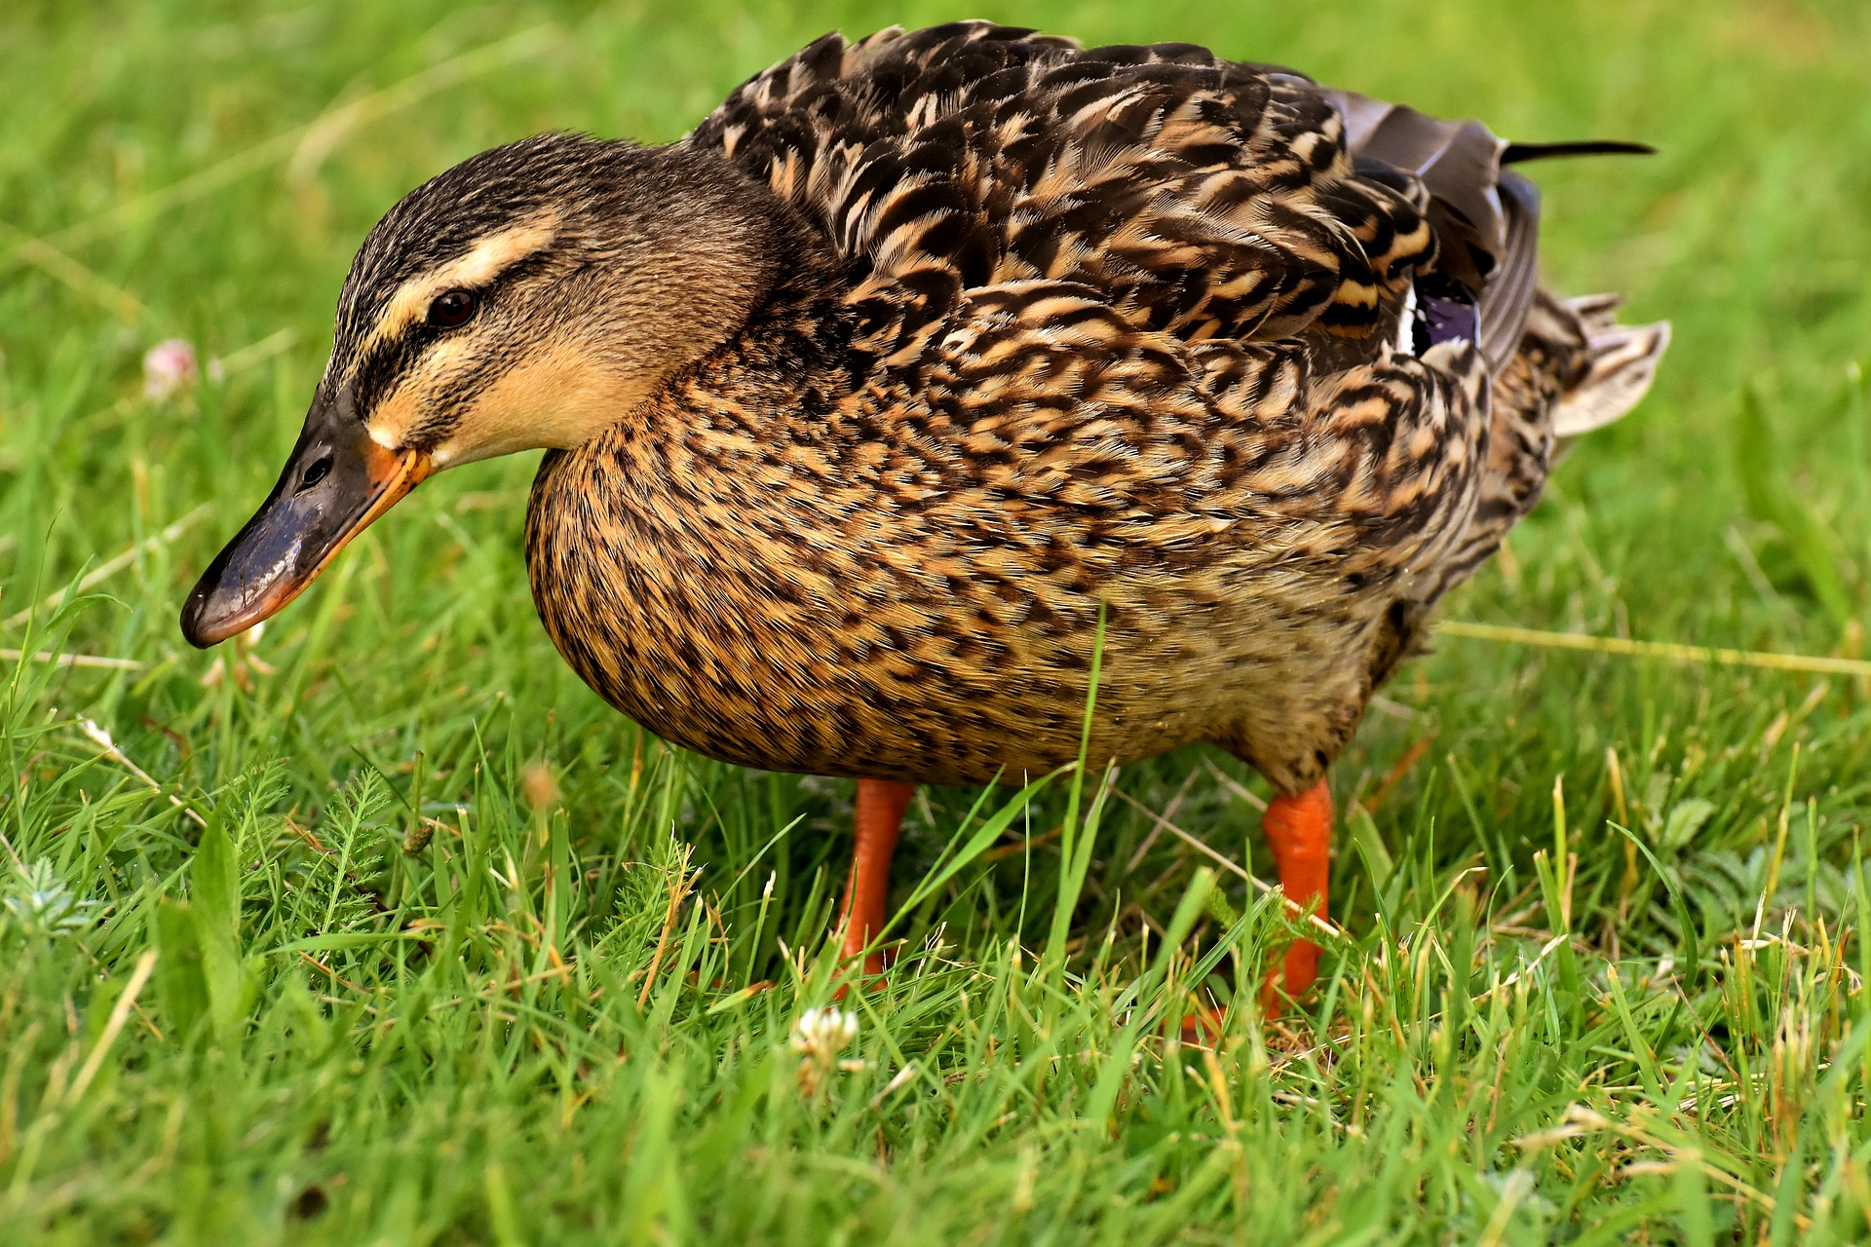
Mallard Duck

Slide 13
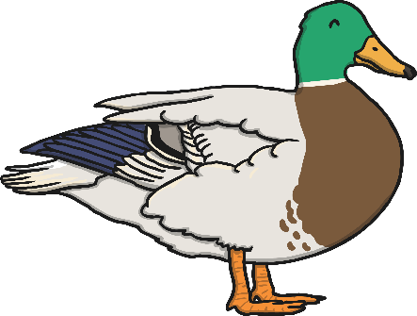
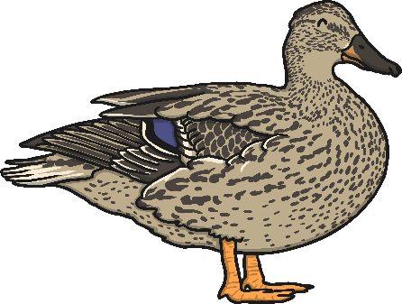
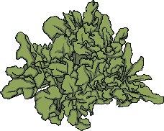
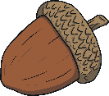
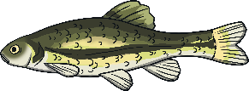
Mallard Duck
Mallards are large ducks that come out during the day.
They live near water, such as lakes and ponds.
They are omnivores. They eat underwater plants, seeds and acorns. They also eat small fish and insects.
male – green, purple-brown and blue feathers
long yellow bill
green head
long black bill
webbed feet for swimming
long body
female – mostly brown feathers with some blue

Slide 14
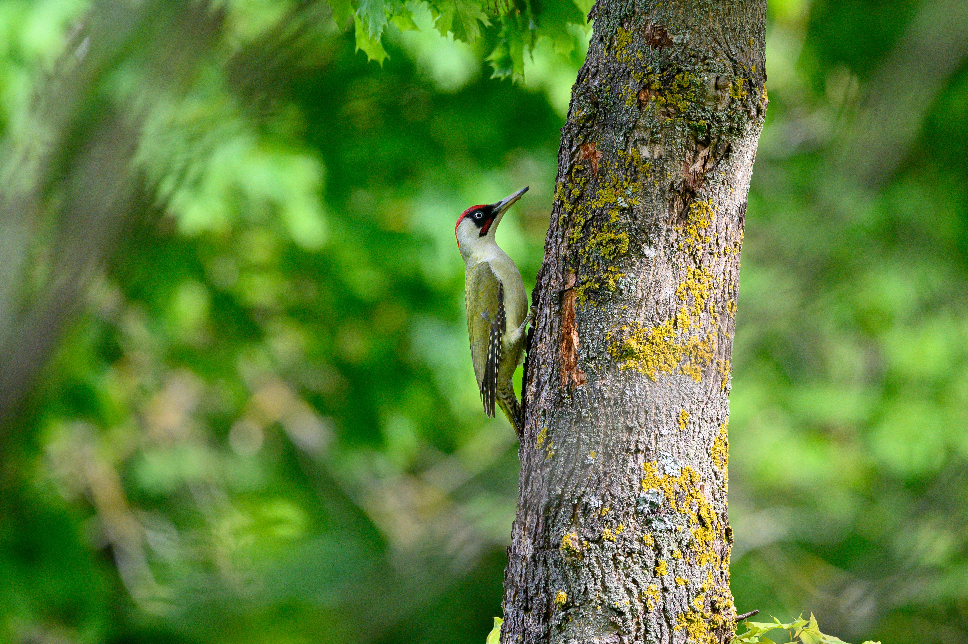
Green Woodpecker

Slide 15
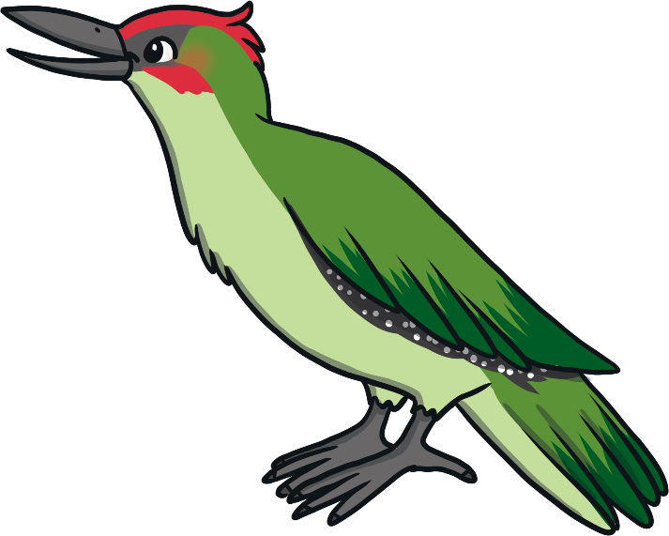

Green Woodpecker
Green woodpeckers come out during the day.
They use their strong beak to dig for ants.
Ants make up most of their diet. They do sometimes eat other insects and some seeds or fruit.
red head
green feathers
strong, long bill for digging up ants
strong claws for gripping the sides of tree trunks

Slide 16
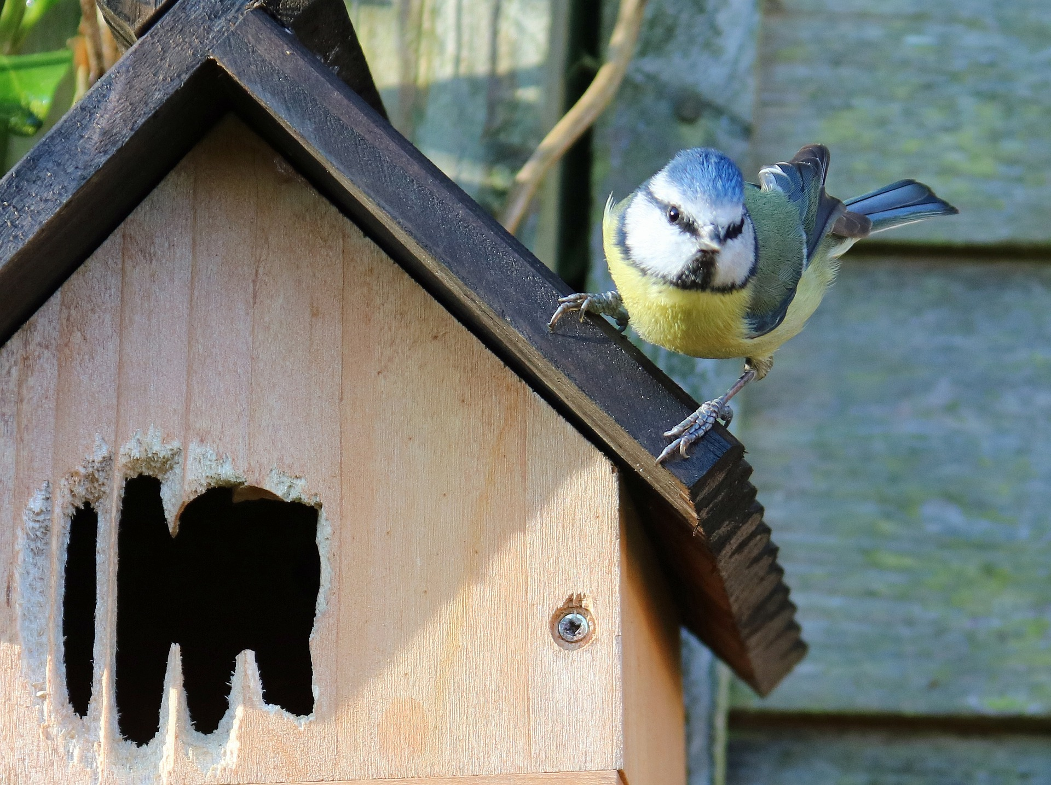
Blue Tit

Slide 17
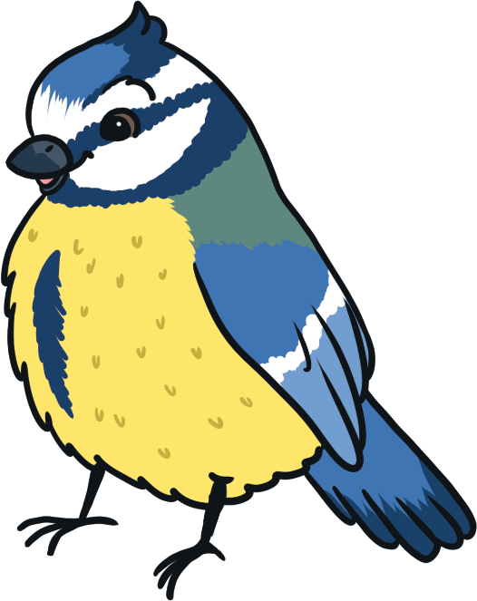
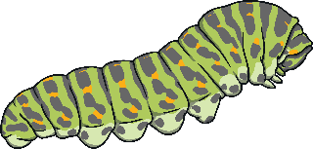


Blue Tit
Blue tits are diurnal birds. They can often be seen in gardens during the day.
Blue tits are omnivores. They eat insects and caterpillars, as well as seeds and nuts.
blue feathers on the back
small beak
long, thin tail
yellow feathers on the belly
small, round body

Slide 18
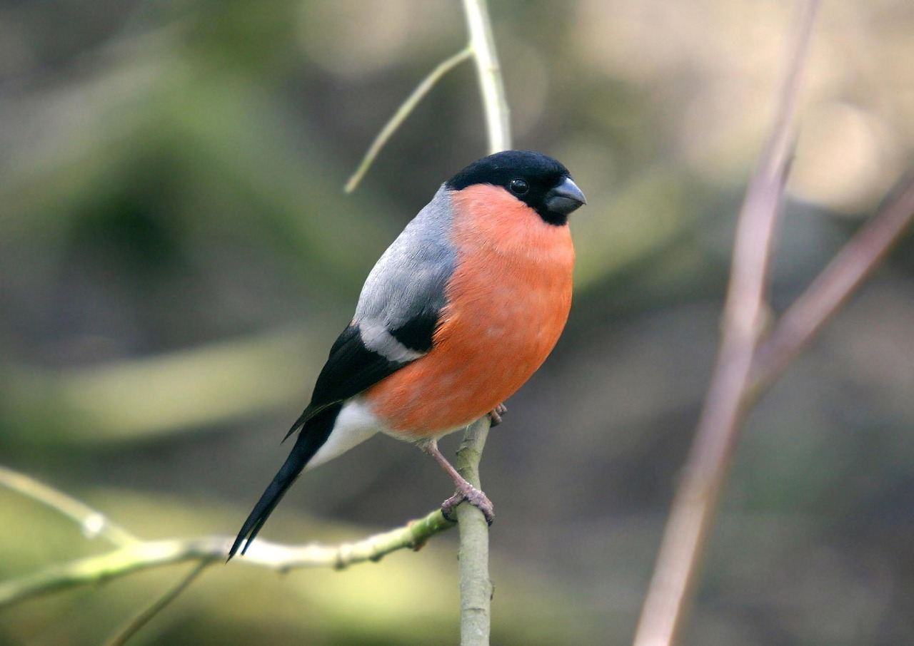
Bullfinch

Slide 19
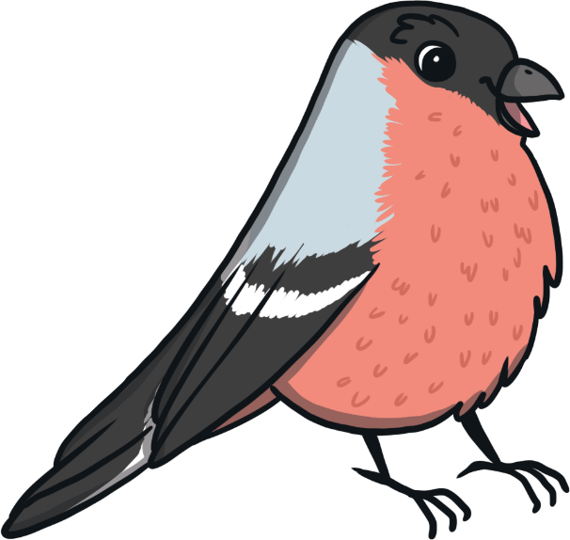
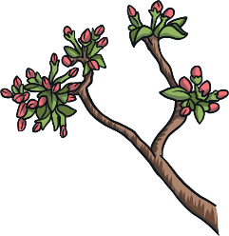

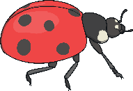
Bullfinch
Bullfinches are awake during the day. They live and hunt in the woods.
Bullfinches are not often spotted in gardens.
Bullfinches eat mostly seeds and flower buds. When they have babies to feed, they also eat insects.
black cap
large but short bill
grey back
pink chest and cheeks
long black tail
round body

Slide 20
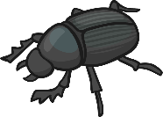




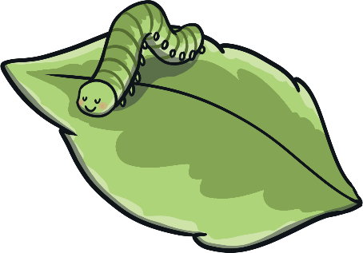
Glossary
carnivore – an animal that eats only other animals
herbivore – an animal that eats only plants
omnivore – an animal that eats plants and animals
predator – an animal that hunts and eats other animals
prey – an animal that is eaten by another
diurnal – awake during the day
nocturnal – awake during the night
camouflage – colours or patterns that help
an animal blend in to its surroundings

Slide 21


