Slide 1
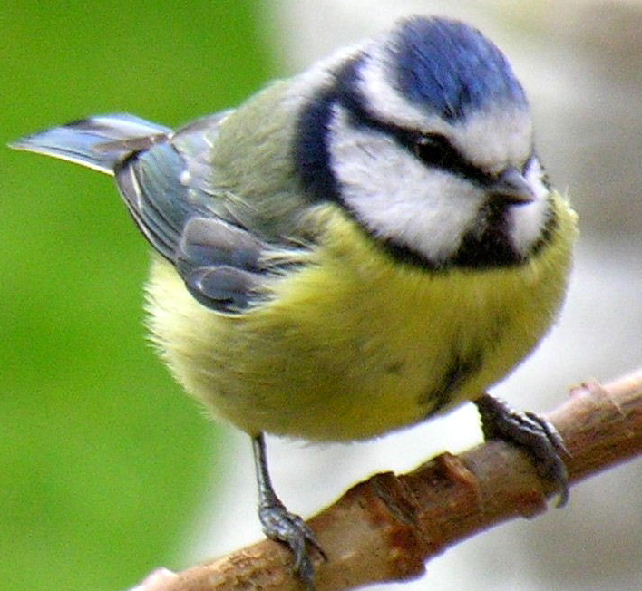
The life cycle of a Blue Tit

Slide 2
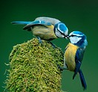
Finding a mate
In March blue tits come together to mate.

Slide 3
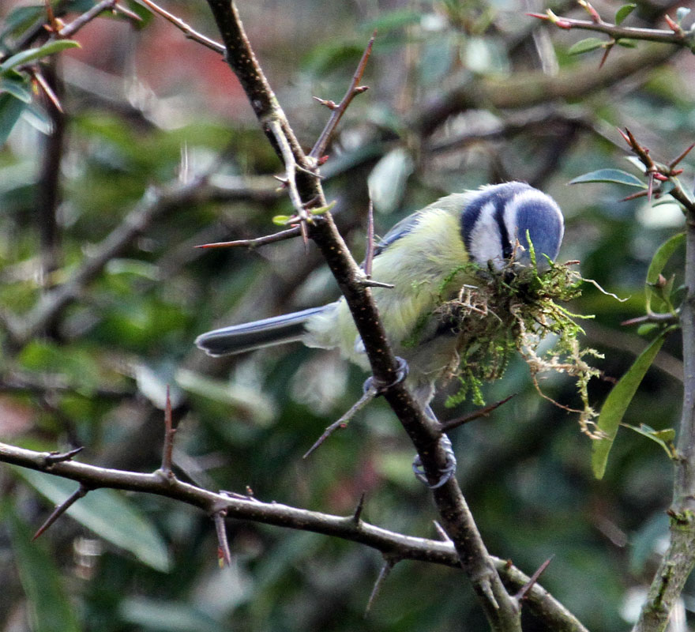
Building a nest
The pair of blue tits build their nest in a small hole in a tree, a crevice in a wall or in a bird box.
It is made from all sorts of materials like grass, hair, wool and moss.
The female lines the nest with feathers from her own body.

Slide 4
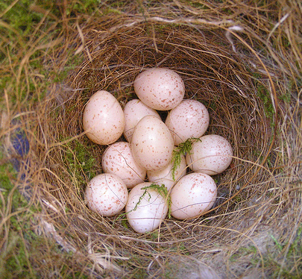
Incubating eggs
By April or May the female is ready to lay her eggs. Each day she lays one egg, until there is a clutch of about 10 -12 eggs.
The female sits on them to keep them warm for about two weeks.

Slide 5
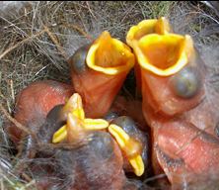
Hatching
Blue tits hatch without any feathers and their eyes are closed. They are completely helpless.

Slide 6
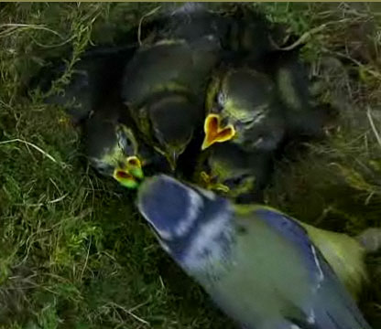
Growing up
The chicks grow quickly and demand lots of food. The parents fly back and forth to supply caterpillars to feed the chicks.

Slide 7
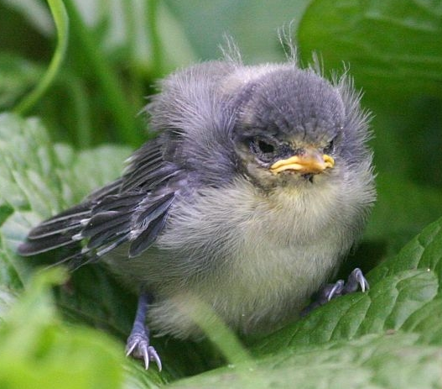
Flying the nest
At around 3 weeks old the chicks are ready to leave the nest. The mother will encourage them to fly by offering a caterpillar on a nearby branch.

Slide 8
Back to the start
Once the chicks leave the nest they will look after themselves.
In Spring, it will find a mate and produce young of its own.

