Slide 2

Hunter-Gatherers
Prehistoric people were hunter-gatherers. This meant they had to find or catch everything they ate.
Early Stone Age people (who lived in what we call the Palaeolithic era) were hunter-gatherers and moved from place to place in search of food. They hunted animals for their meat and their skins which they used as clothes. Those who lived near water caught fish using nets. They collected fruit and nuts to add to their diet.
The later phase of the Stone Age is known as the Neolithic era and this is when Stone Age people stopped being hunter-gatherers and started to farm.
Click on the words in bold to find out what they mean.
Talk about it.
If you were a hunter-gatherer, what plants might you use that grow near where you live?

Slide 3
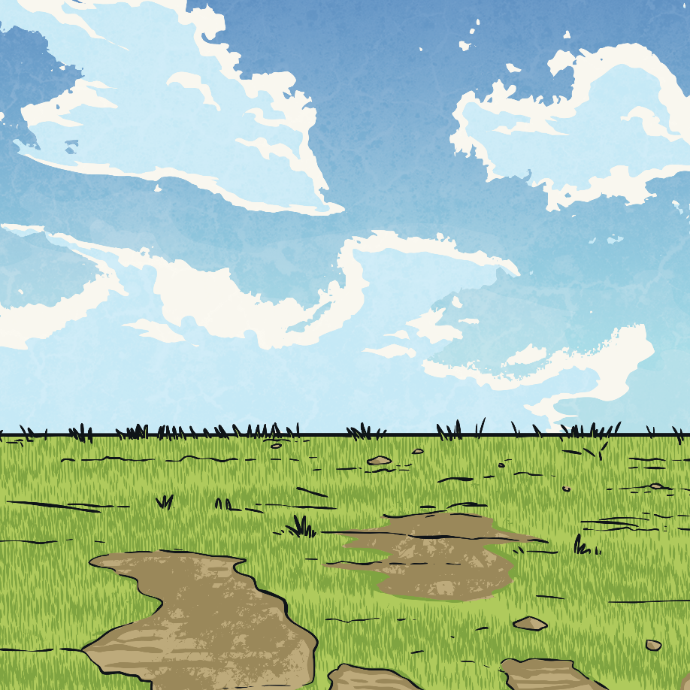
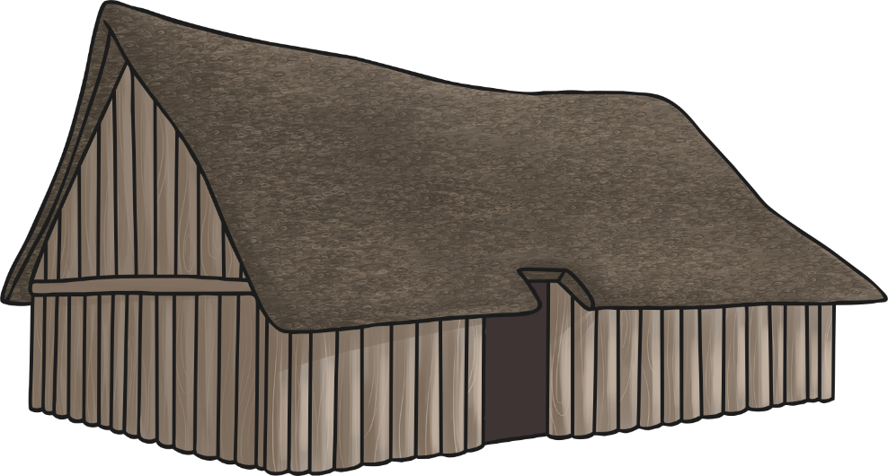

The Start of Farming
Farms were made by clearing wooded areas and building houses surrounded by farms. The wood was used to build houses and for fuel. By 3500 BC, there were farms all across the Stone Age world.
The Neolithic era started around 4000 years ago. People stopped being hunter-gatherers and started producing their own food. This meant that Stone Age people stopped being nomadic and began to build settlements. Being hunter-gatherers meant there wasn’t always a reliable supply of food. Farming their own food meant people could guarantee there would be enough to eat and that tribes could settle in one area for the whole year.
Click on the words in bold to find out what they mean.

Slide 4
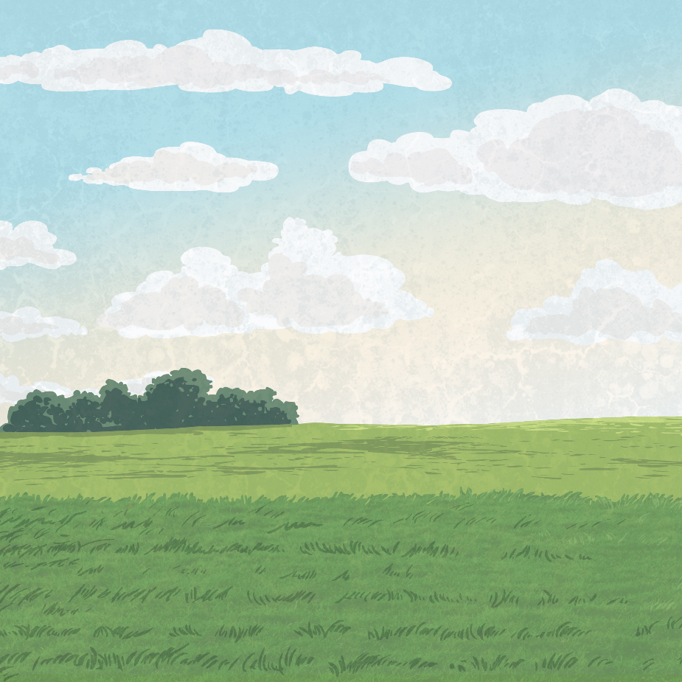
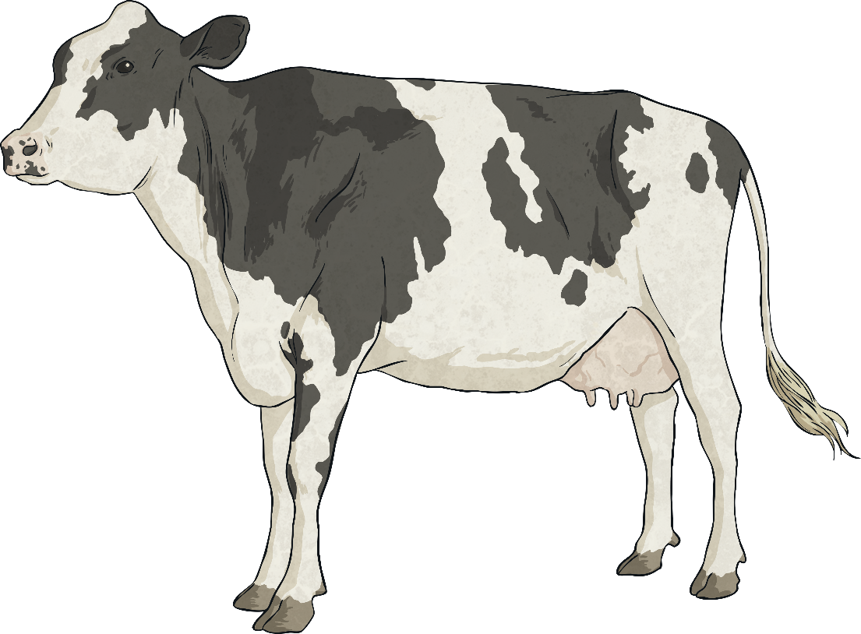
Animals
Stone Age farmers domesticated animals. These animals included cows, sheep, goats and pigs.
Talk about it.
What could farmers get
from each animal?
The farmers could get:
meat, milk and leather from cows;
meat, milk and wool from sheep
and goats;
meat from pigs.
Click on the words in bold to find out what they mean.

Slide 5
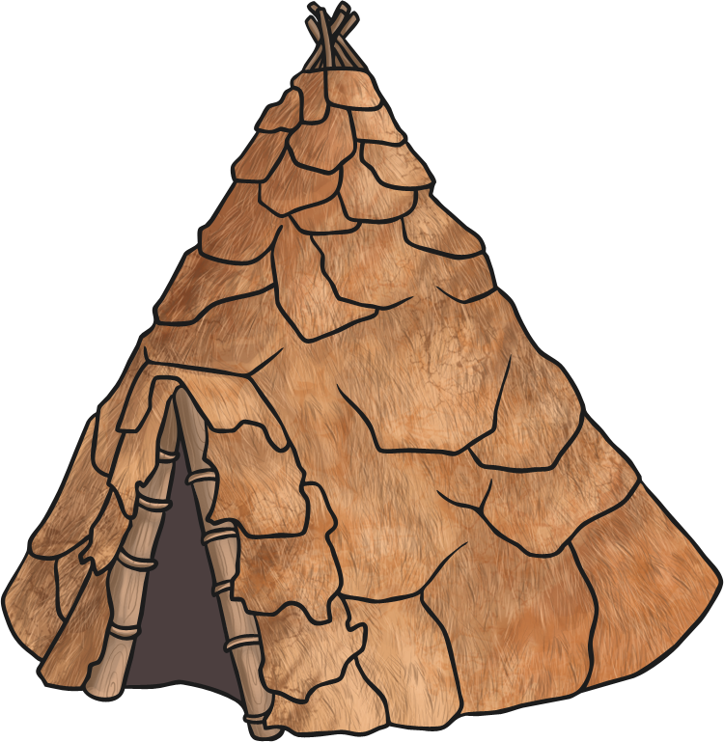
Crops
Farmers grew a variety of crops. Wheat and barley were used to make flour, which was then turned into bread and porridge. A plant called flax was turned into material to make clothes. Other farmers grew beans and peas.
Did You Know?
A piece of bread from the Stone Age was found in Oxfordshire. Archaeologists think it was
from around 3600 BC!

Slide 6
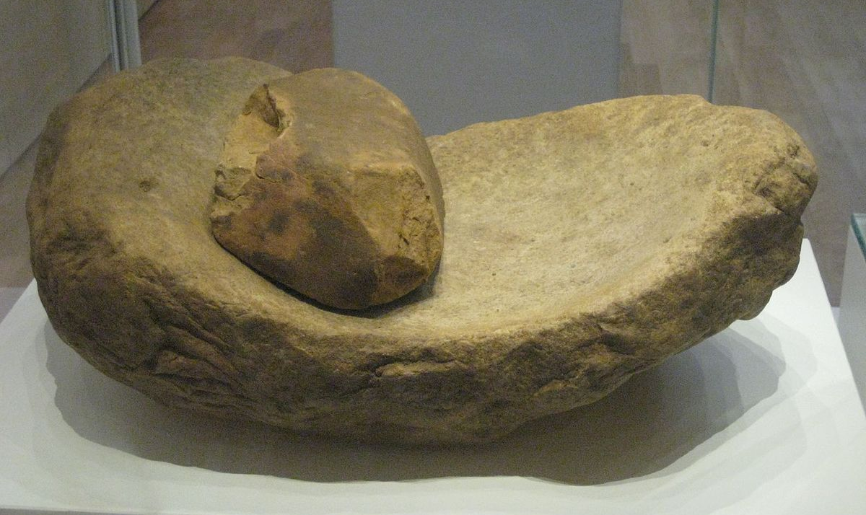
Tools
As the name suggests, the Stone Age was a time when tools were mostly made of stone. The age ended when people began to smelt metal to use for tools.
A quern was used to grind wheat into flour. It was made of two stone circles. The one on the bottom didn’t move. The upper stone had a hole in the middle and could turn round. Wheat was poured into the hole and then the top stone was turned using a handle. This ground the wheat into flour.
An upper quern stone
Click on the words in bold to find out what they mean.
By Green Lane - Own work, CC BY-SA 3.0.

Slide 7
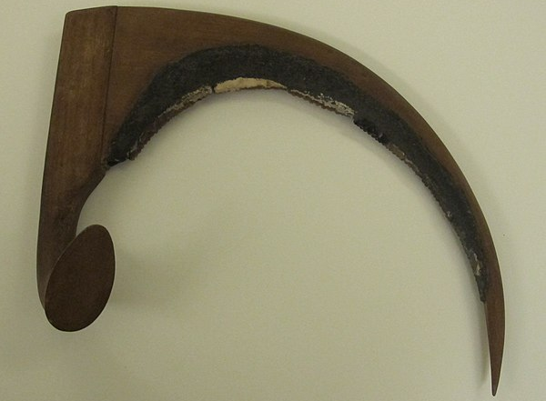
Tools
Farmers began to use wooden ploughs pulled by cattle to prepare the ground for crops to be grown.
Crops were harvested using sickles made from a rock made out of flint.
Flint sickle
By Roger Fund- Own work, CC BY-SA 3.0.

Slide 8
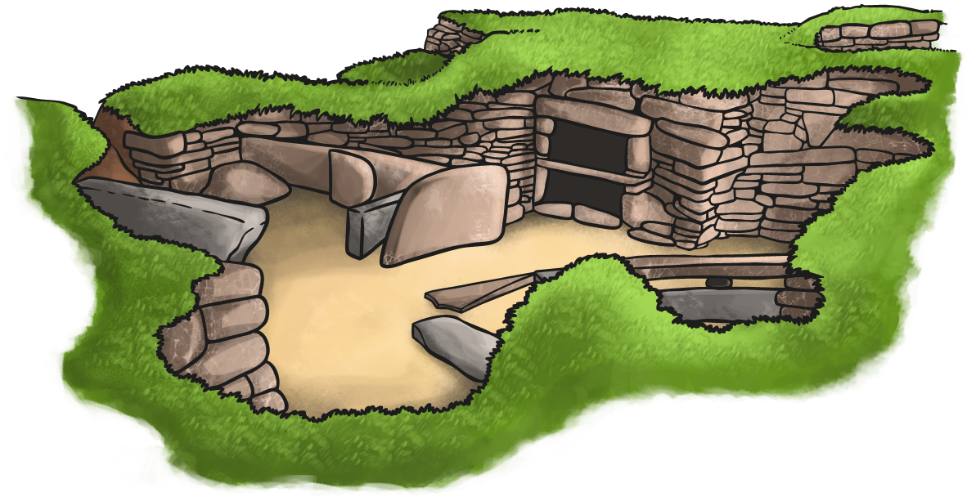
How Do We Know?
Archaeologists have excavated many sites and discovered artefacts from the Stone Age. These include parts of tools and the bones of animals.
In 1850, a storm uncovered the remains of a Neolithic village called Skara Brae off the coast of Scotland. The village was well preserved and has helped archaeologists learn lots about Stone Age life.
Click on the words in bold to find out what they mean.

Slide 9
Glossary
artefacts – Objects from the past.
archaeologists – The people who study human history and prehistory.
domesticated – To tame a wild animal.
excavated – Dug up to uncover things from the past.
nomadic – A group of people who don’t have a settled home but move from place to place.
prehistoric - The period of history before written records.
smelt – The heating and melting of an ore (a material from nature) to get metal.

