Slide 1
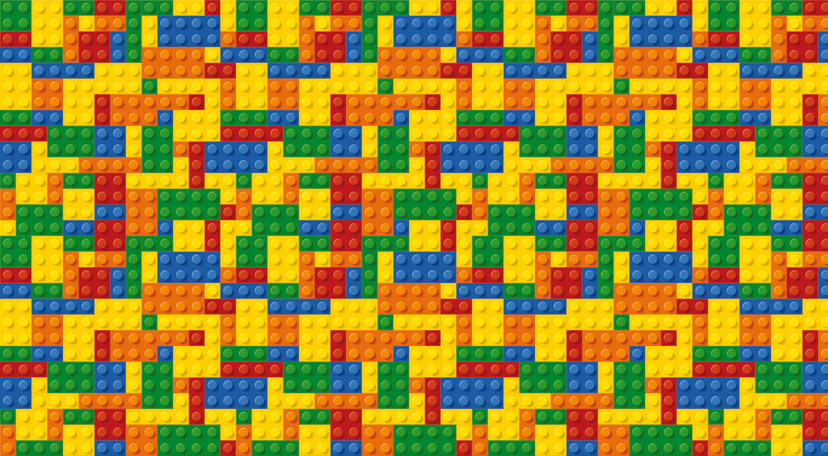
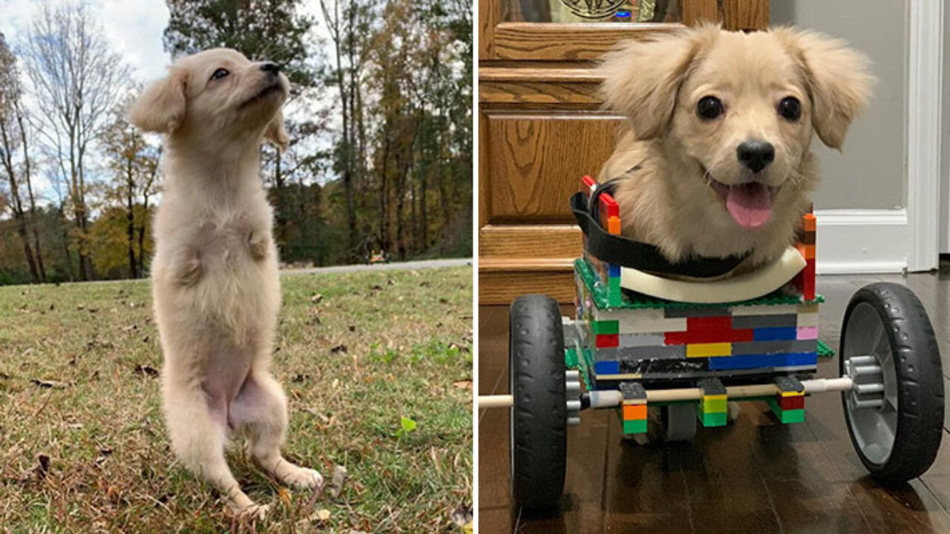
Lego Challenge: Animal Aid
Your Challenge!
Just like humans sometimes have injuries that require them to use things like wheelchairs and walkers, animals can get injuries like that too. Build an animal with an injury, and come up with a device that will help its injury heal and allow the animal to continue to live in the wild
Case study 1
Winter was found stranded in Mosquito Lagoon, near Cape Canaveral, Florida when she was only two months old, entangled in a crab trap line which cut off circulation to her tail flukes. Despite exhaustive efforts to promote healing, her tail deteriorated and could not be saved. Winter had a prophetic tail attached which allows her to swim.
Engineering Goals:
Learn to design for a unique client (animal)
Design with specific constraints (the solution has to allow the animal to stay in its natural habitat)
Case study 2
When an injured turtle was brought to the maryland zoo’s hospital for treatment of fractures on the bottom part of his shell, doctors knew they needed an inventive solution to both help maintain his mobility and allow him to heal properly. following a surgical procedure to stabilize the wild eastern box turtle’s severely fractured shell, the veterinary team realized the importance of keeping the bottom of the shell off the ground so it could heal properly. ‘they don’t make turtle-sized wheelchairs,’ said garrett fraess, veterinary extern at the zoo ‘so, we drew some sketches of a customized wheelchair and I sent them to a friend who is a LEGO enthusiast.’.
Reflection Questions
What should I do first?
Is something confusing me?
Could I explain this to someone else?
Where can I look for help?
How can I do it better?

