Slide 1
Liverpool History
Lesson 2

Slide 2
W.A.L.T. – To locate important buildings and find construction dates.

Slide 3
Liverpool’s wealth as a great port city enabled the construction of many great buildings. Liverpool’s architecture is beautiful, fascinating and varied. Dating from the last 300 years, Liverpool’s buildings tell the story of a port of worldwide importance, whose fortunes declined in the twentieth century and is now experiencing a renaissance as a cultural capital
The twentieth century saw the development of the Pier Head, and what would come to be known as the Three Graces. Atop the Royal Liver Building (1908–11) sit the two famous two Liver Birds, the symbols of Liverpool. The Cunard Building (1914–17) is the former headquarters of the Cunard shipping company, and the Port of Liverpool Building (1903–07) is the home of the former Mersey Docks and Harbour Board.
Both cathedrals date from the 20th century. Liverpool Anglican Cathedral is Britain’s biggest Cathedral, designed by Sir Giles Gilbert Scott, and took 74 years to build from the foundation stone being laid in 1904. It is breathtaking in both scale and intricacy.

Slide 4
The Metropolitan Cathedral was originally conceived as a huge structure in a similar style to the neo-gothic Anglican Cathedral. Of that design, only the Lutyens Crypt was built and due to the pressures of war and rising costs, the design was abandoned. The current modern, circular Cathedral opened in 1967, and features glorious multi-coloured windows. The original Lutyens Crypt can still be seen.
South of the city, the art deco former terminal building of Speke Airport, used from the 1930s to 1986, is now the Crowne Plaza.
In 2004, Liverpool was declared a UNESCO World Heritage Site. Comprising six locations in the city, Liverpool Maritime Mercantile City includes the Pier Head, Albert Dock and William Brown Street and many of Liverpool’s famous landmarks.
One of the more striking modern buildings is the waterfront Museum of Liverpool, opened in 2011.

Slide 5
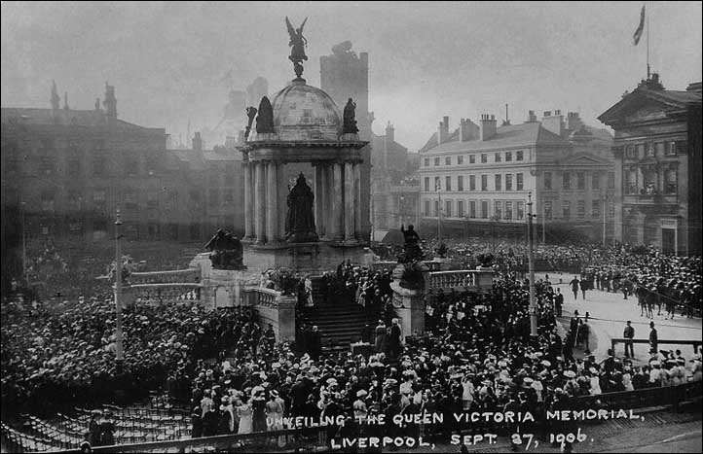
The Victoria Monument was built in 1901.

Slide 6
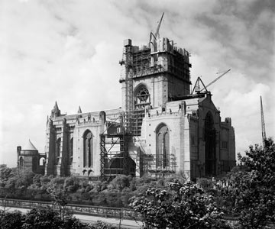
Work on the Anglican Cathedral was extensive and began in 1901 but was not completed until 1978..

Slide 7
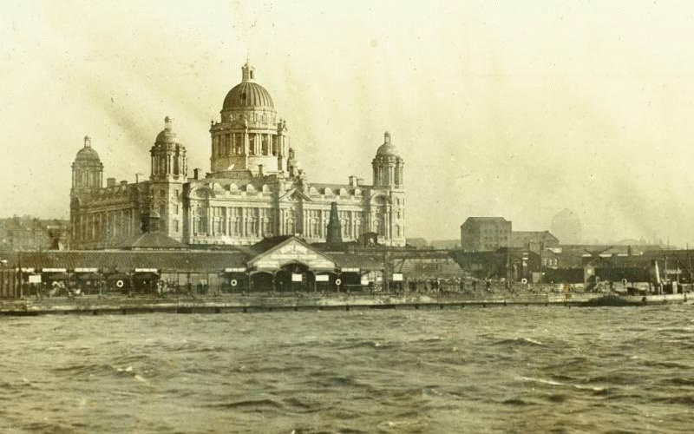
Construction on the Port of Liverpool building began in 1903 and was completed in 1907.

Slide 8
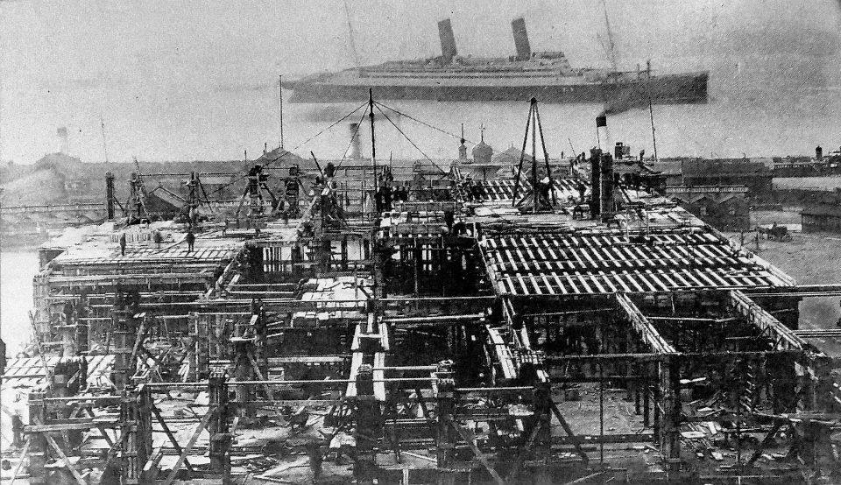
Construction started on the Liver Buildings in 1908 and completed in 1911.

Slide 9
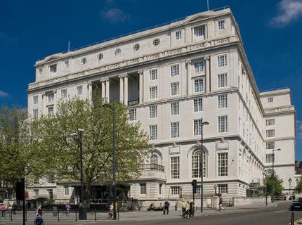
The Adelphi was one of the most luxurious hotels when it opened in 1914.

Slide 10
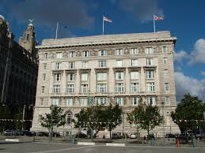
The Cunard building was the last of the 3 Graces to be constructed, between 1914 and 1917.

Slide 11
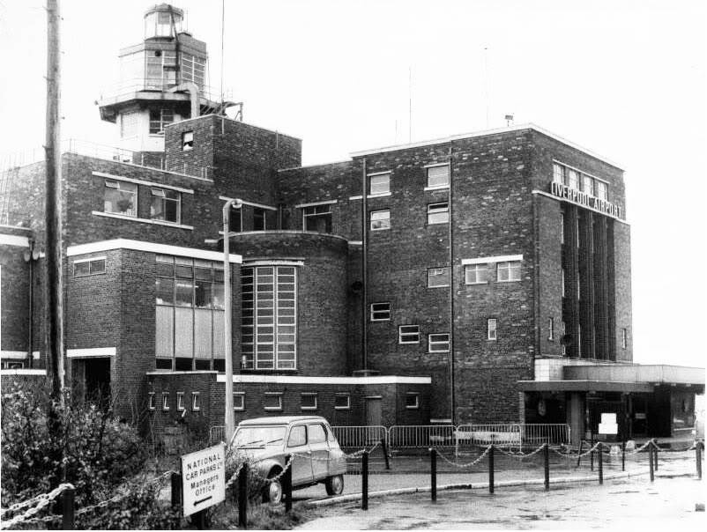
Liverpool Airport opened in 1930.

Slide 12
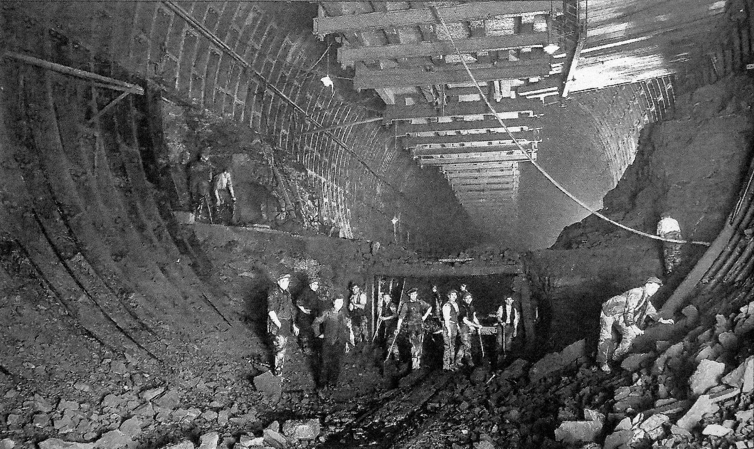
The Queensway tunnel was opened on 18th July 1934 after construction started in 1925.

Slide 13
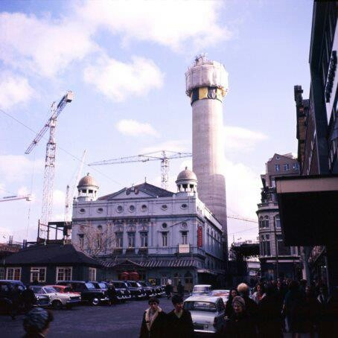
St John’s shopping centre and beacon were constructed in 1969. the Beacon was originally a revolving restaurant before later becoming the Radio City Tower.

Slide 14
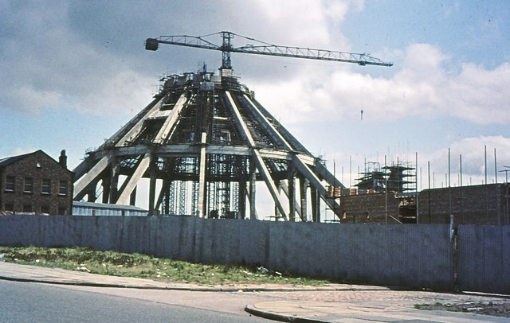
The Metropolitan Cathedral was constructed in 1967.

Slide 15
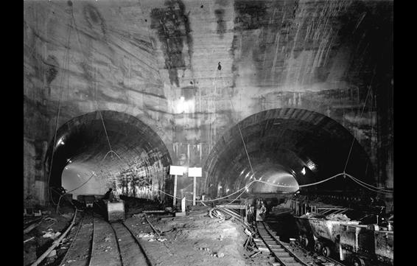
The Queensway tunnel opened in 1971.

Slide 16
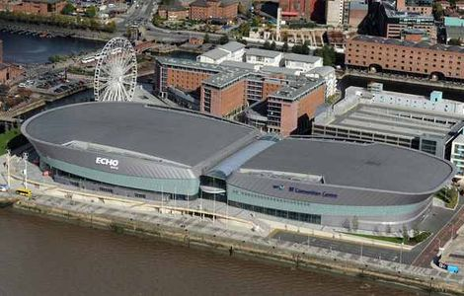
The Liverpool Echo Arena and BT Convention Centre opened in 2004.

Slide 17
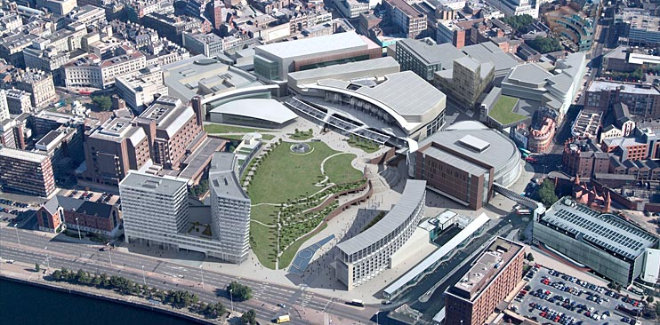
The Liverpool One Shopping Centre complex was opened in 2008.

