Slide 1
Liverpool History
Lesson 4

Slide 2
W.A.L.T. – What impact did WW1 have on the city of Liverpool?

Slide 3
Wars are won and lost on the home front. So to fully understand the history of any war it is important to get some sense of how those who remained on the home front contributed to the war effort and how they experienced the war. In one way or another, each part of the British Isles was affected by the First World War. Merseyside’s role in shipbuilding and the import and export of goods meant that it played a central part in the conflict. But not everyone in the region saw or experienced the war in the same way. Some attacked German shops while others tried to protect families whose main breadwinner had gone to war. Workers defended their interests and pacifists resisted conscription. Almost everyone eagerly awaited news from the front.

Slide 4
As the ‘second city of empire’, Liverpool and its environs played a pivotal role in the war. Even before the conflict, the port was a life line. In all, by 1914 some 31 per cent of imports and exports passed through the port. This share increased during the war because many southern English ports were closed. Ships were like red blood cells that carried the oxygen of commerce to all parts of the globe. Some idea of the importance of Merseyside as a shipping centre can be seen in the 74 per cent profit made Cammell Laird by 1916, though this company was also involved in munitions, another industry that grew during wartime.

Slide 5
3rd August 1914 was a sunny bank holiday. Thousands of Merseysiders spent it at the popular resort of New Brighton, strolling along the promenade and enjoying one of the last summers of peace. The day after, at 11pm on the 4 August, Great Britain declared war on Germany and plunged Europe into war which decimated a generation.
The peacetime Army was too small to mobilise for a European war alone and it was decided to introduce voluntary recruitment for the first time. Like most regions, Merseyside also had its own territorial units, six in total which belonged to the Kings (Liverpool Regiment).
Despite the strength of these battalions, Lord Kitchener, the Secretary of State for War, decided not to use the territorial units to supplement the Army.

Slide 6
On 7 August 1914, Kitchener appealed for 100,000 men to volunteer for the Army. In Liverpool, poverty and unemployment combined with the tradition of voluntary service that went back to the Napoleonic wars and anti-French sentiment meant that men rushed to the nearest recruitment office to sign up. By 23 August, Kitchener had his 100,000 who were organised into the 11th Battalion, the first Service battalion in the country and a pioneer unit in Britain. On 28 August, Kitchener called again for another 100,000 men. At this point in the war, British forces had been engaged in two major battles, the battle of Mons and Le Cateau. Although the national press was doing it’s best to maintain morale, it was clear that the Army was struggling. The men of Liverpool once again answered Kitchener’s call. By the end of the month, daily recruitment figures had broken all records.

Slide 7
On 27 August 1914, the 17th Earl of Derby urged businessmen to serve together in battalions of comrades. It was believed that educated, white collar workers would prefer to serve with their workmates rather than being spread across various regiments. The new groupings were to be called Pals, and Derby hoped that 1000 men would come forward. In 36 hours, 2000 men volunteered and three battalions were raised in just over a week. 4000 men volunteered to serve in total and they were formed into four battalions
5,000 men joined the Liverpool Pals battalions.
2,800 of them died in the war.

Slide 8
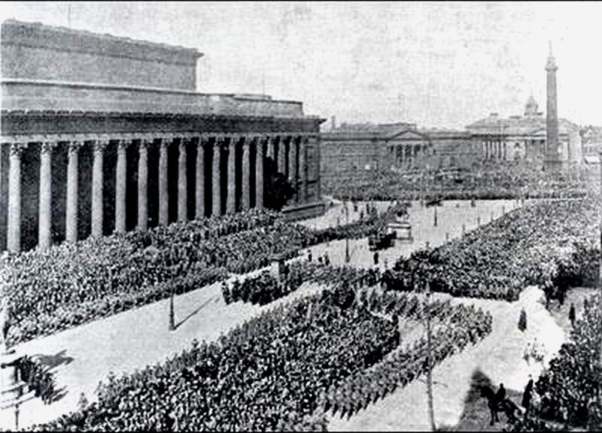

Slide 9
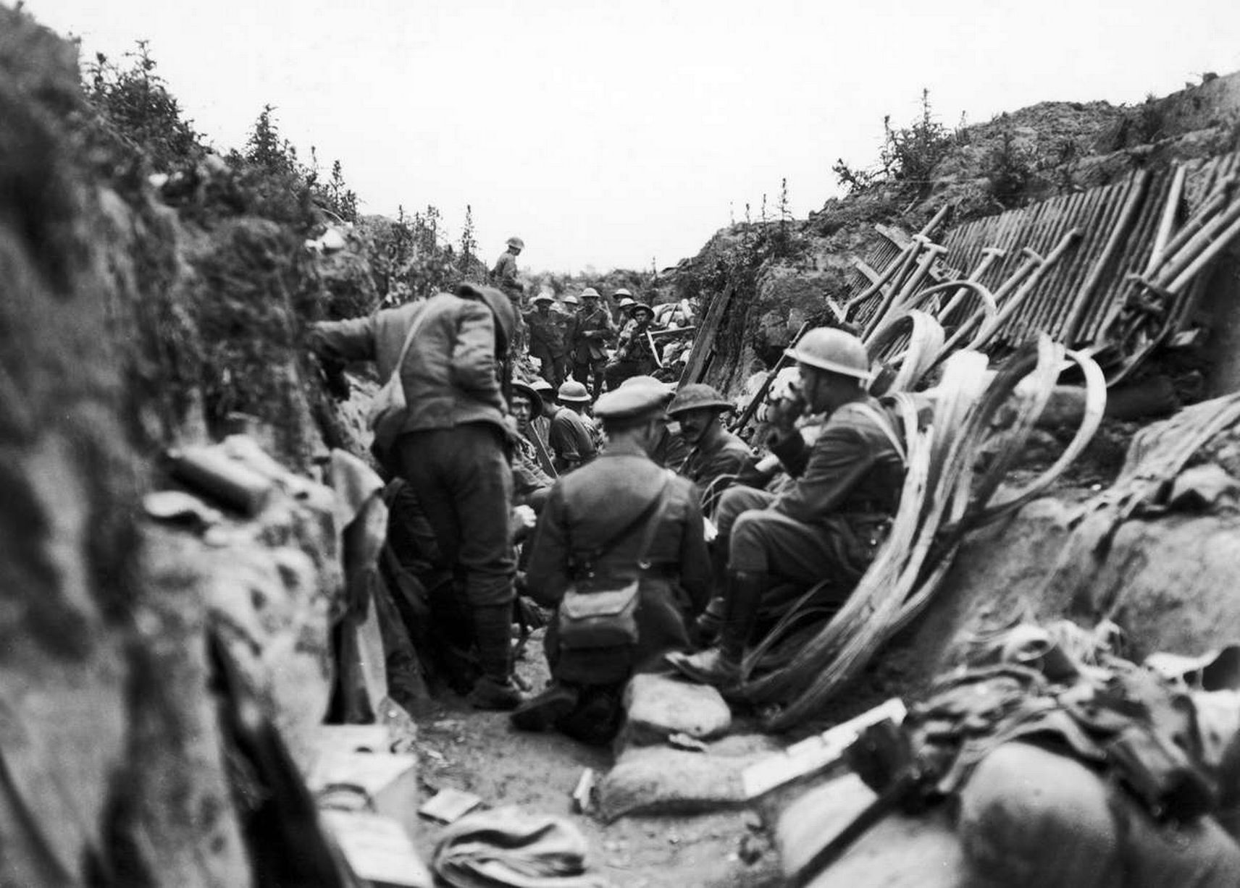

Slide 10
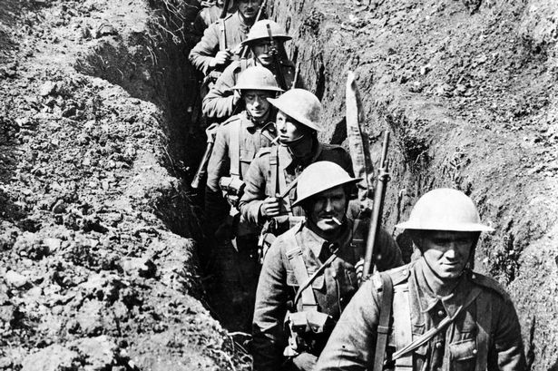

Slide 11
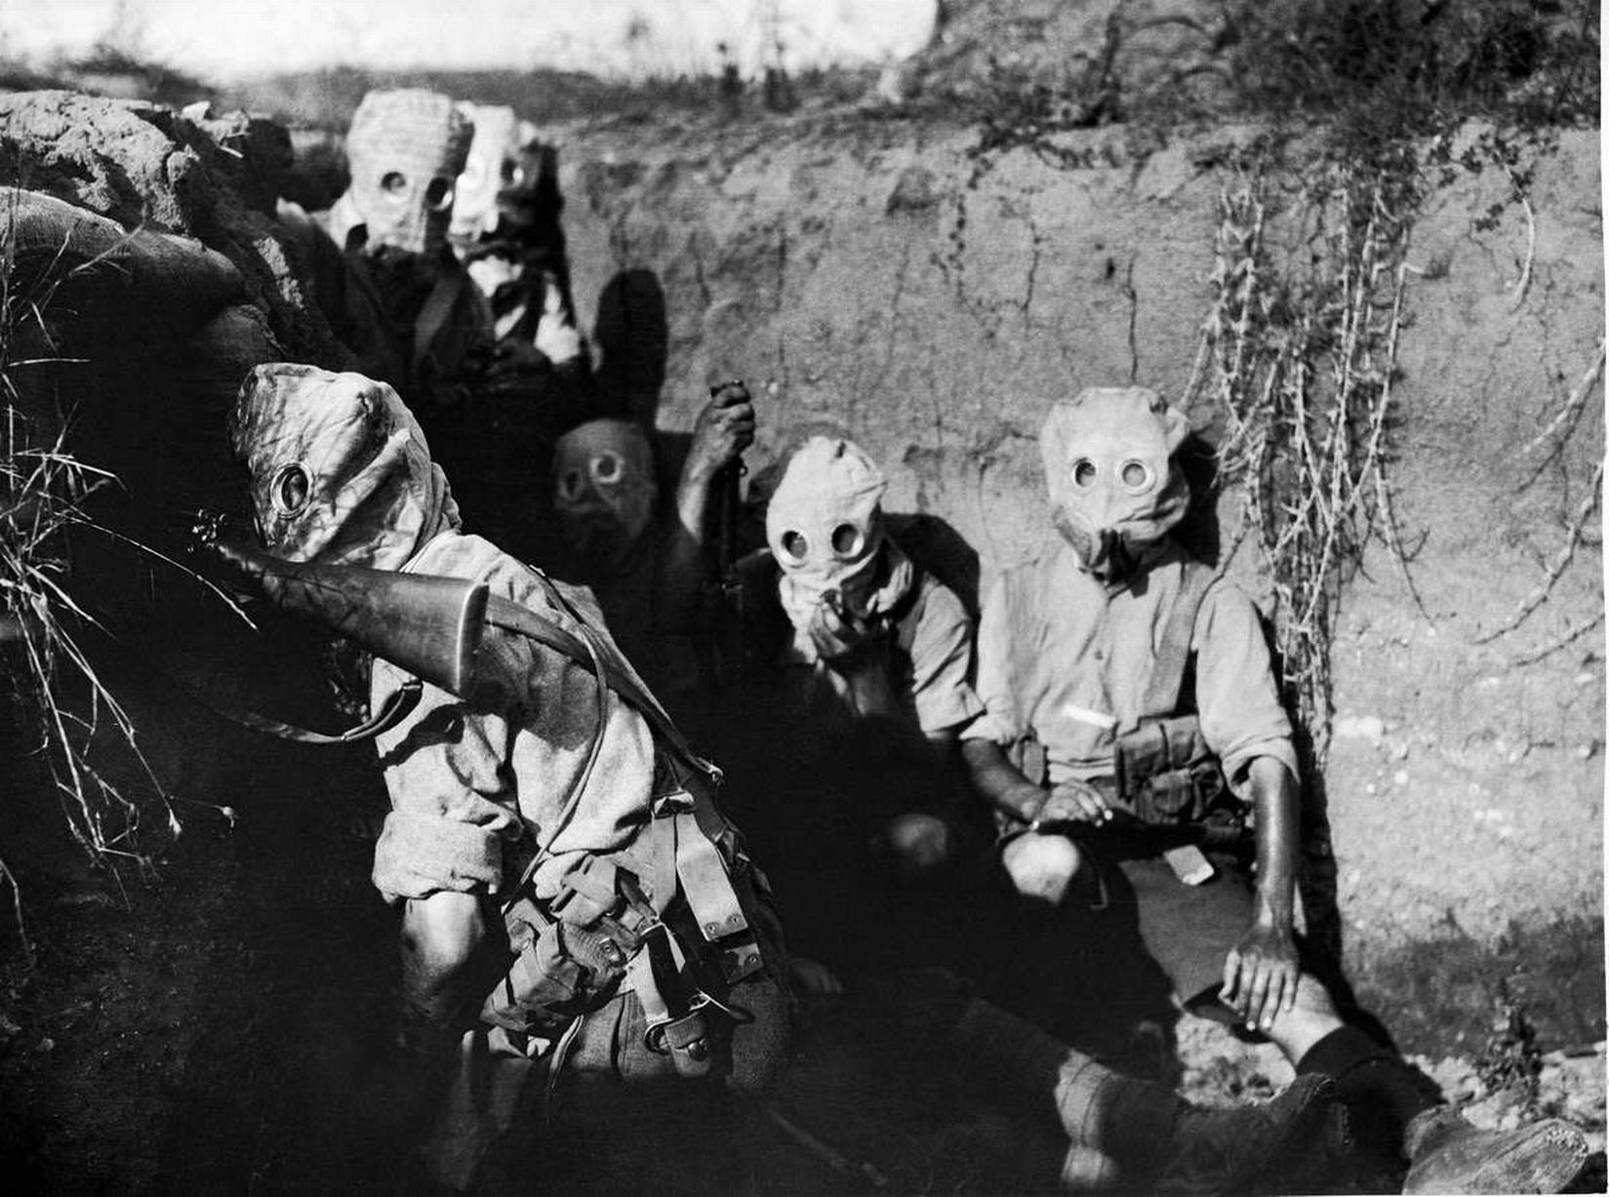

Slide 12
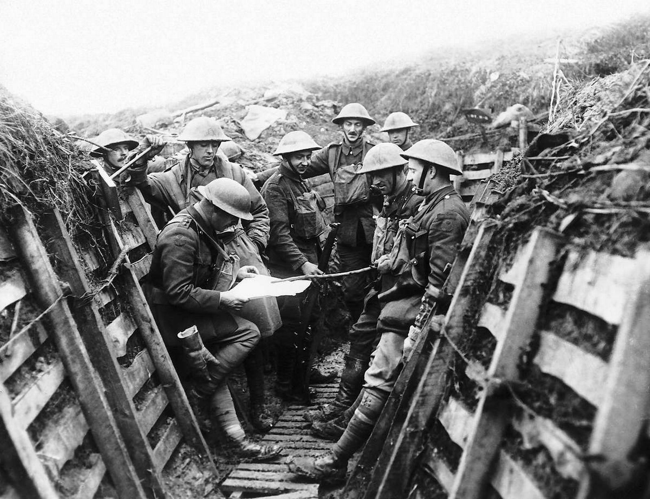

Slide 13
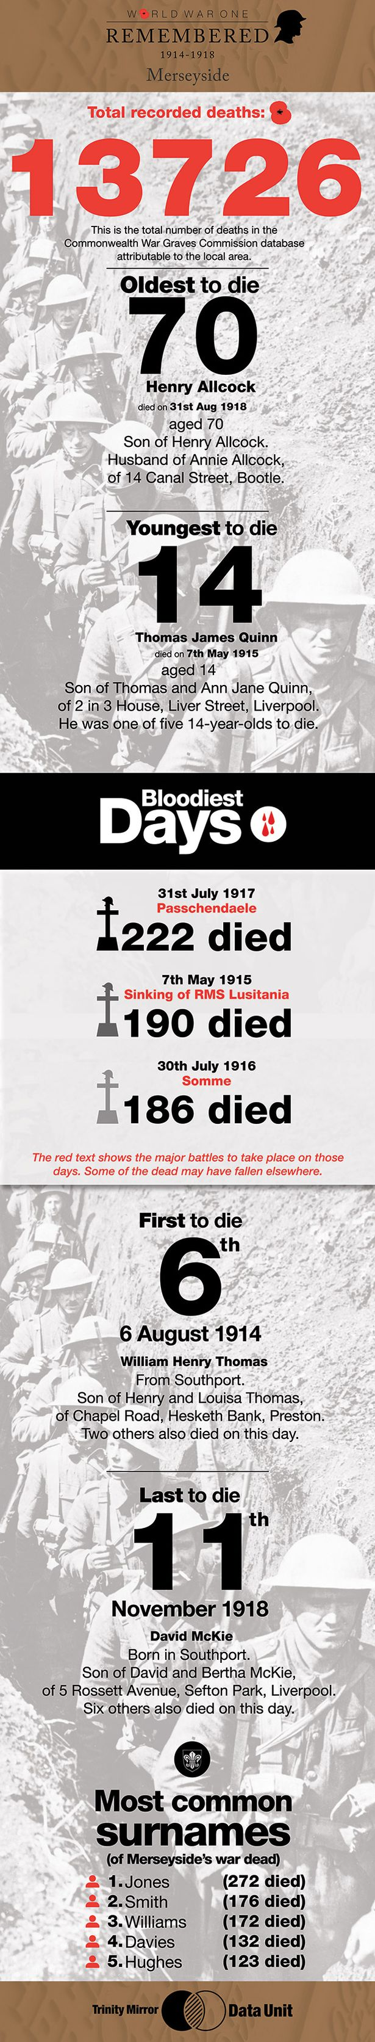

Slide 16
Life at home

Slide 17
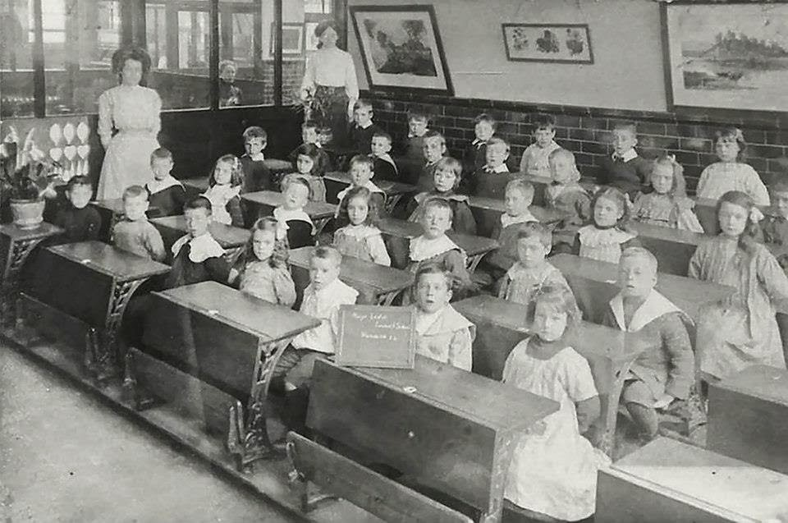

Slide 18
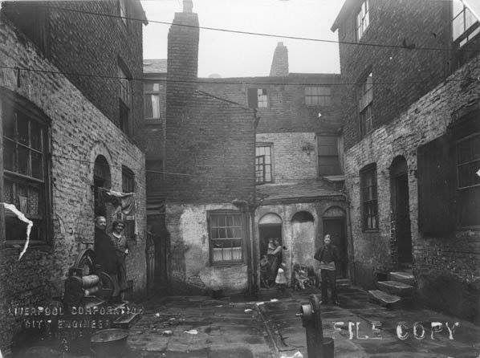

Slide 19
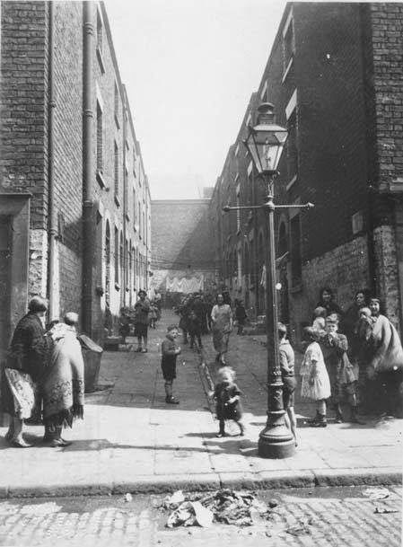

Slide 20


