Slide 1
Liverpool History
Lesson 5

Slide 2
W.A.L.T. – What was life like In Liverpool during WW2?

Slide 3
Liverpool’s port and shipping companies such as White Star Line and Cunard meant that Liverpool was an important city to the British Empire. With its large port and local industries, Liverpool’s contribution to the war effort was crucial.
Most ships carrying war supplies docked in Liverpool delivering food, fuel, weapons and troops. The port was also the country’s main link to the USA. This made Liverpool a key target for German bombs. From 1940 to 1942, Liverpool was bombed by German planes in what became known as the Blitz. The heaviest bombing took place during the first week in May 1941.
Although 130,000 Liverpudlians were evacuated from the city to live in safer areas, almost 4,000 local people were killed during the Blitz. Around 6,500 homes were destroyed and a further 190,000 were damaged. After the war, much fo teh city needed to be rebuilt.

Slide 4
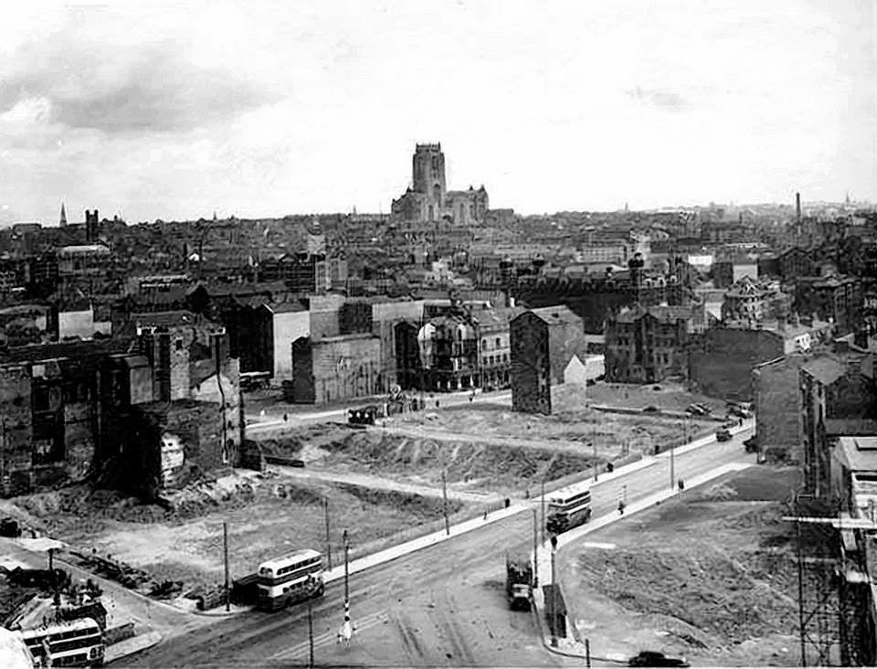

Slide 5
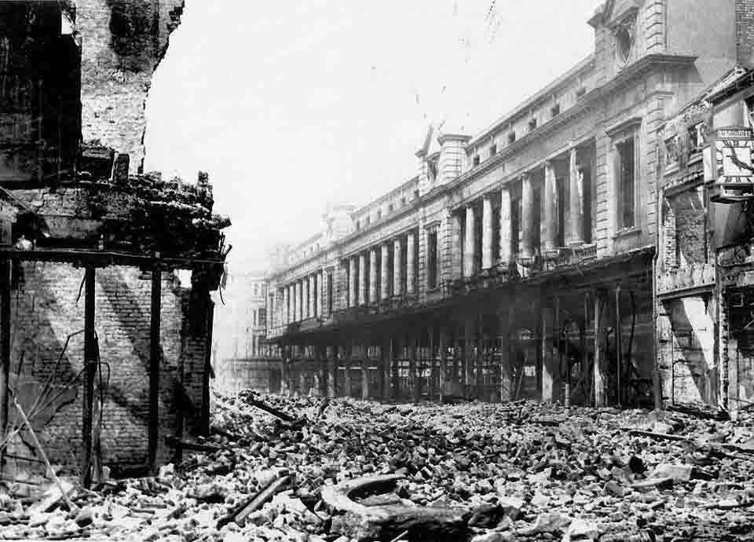

Slide 6
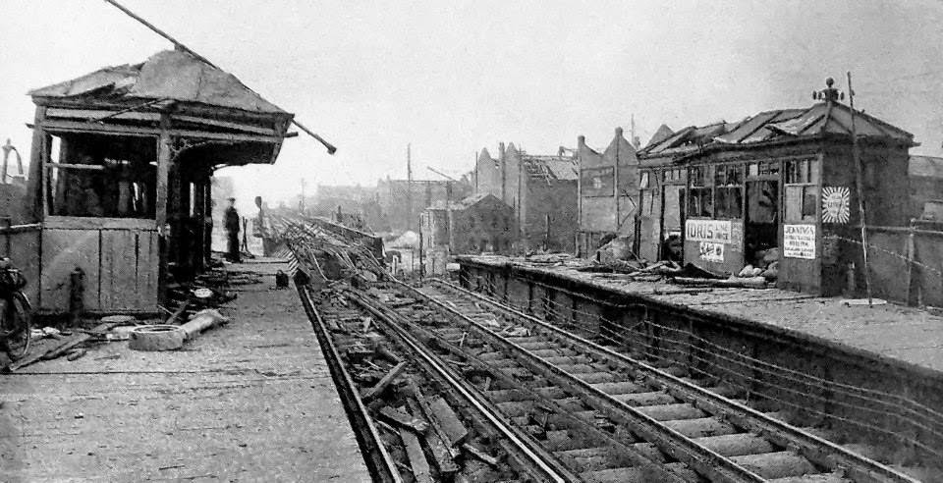

Slide 7
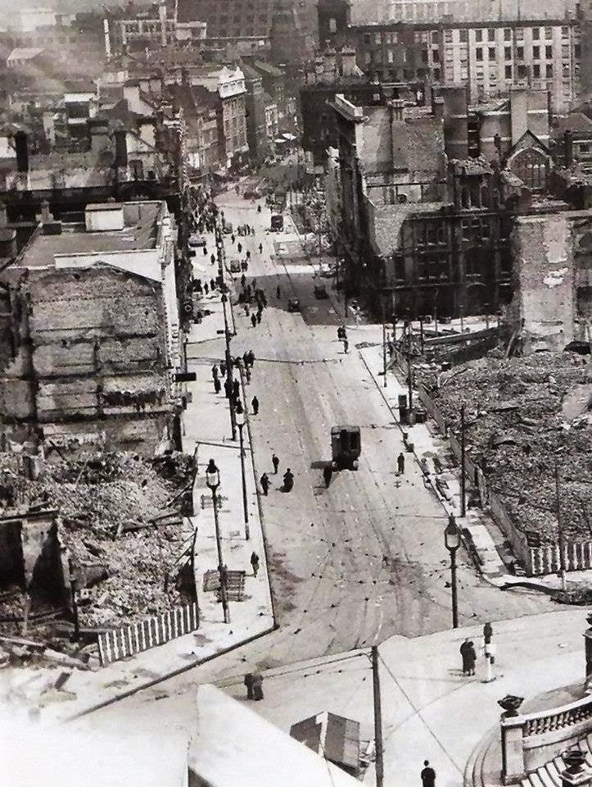

Slide 8
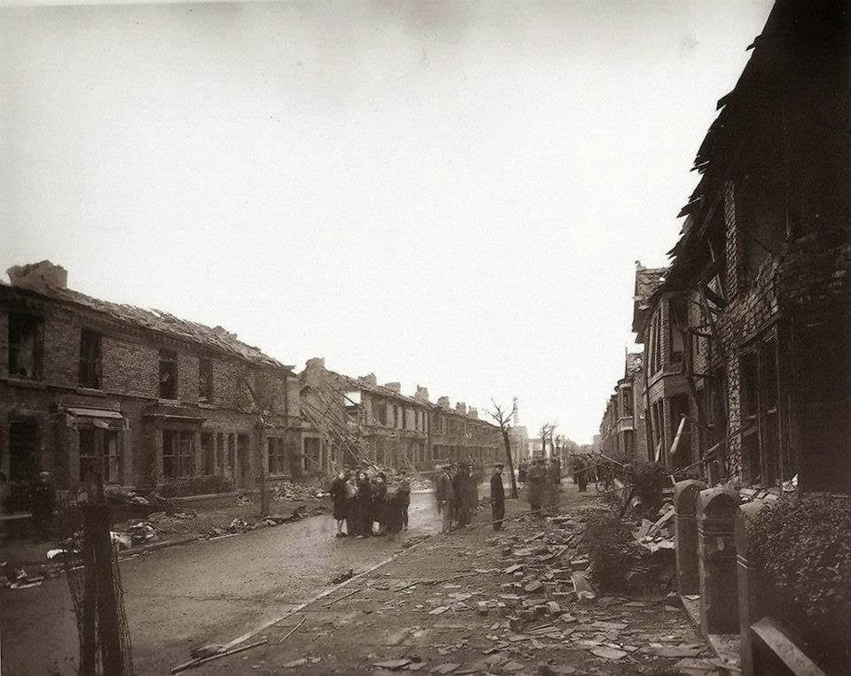

Slide 9
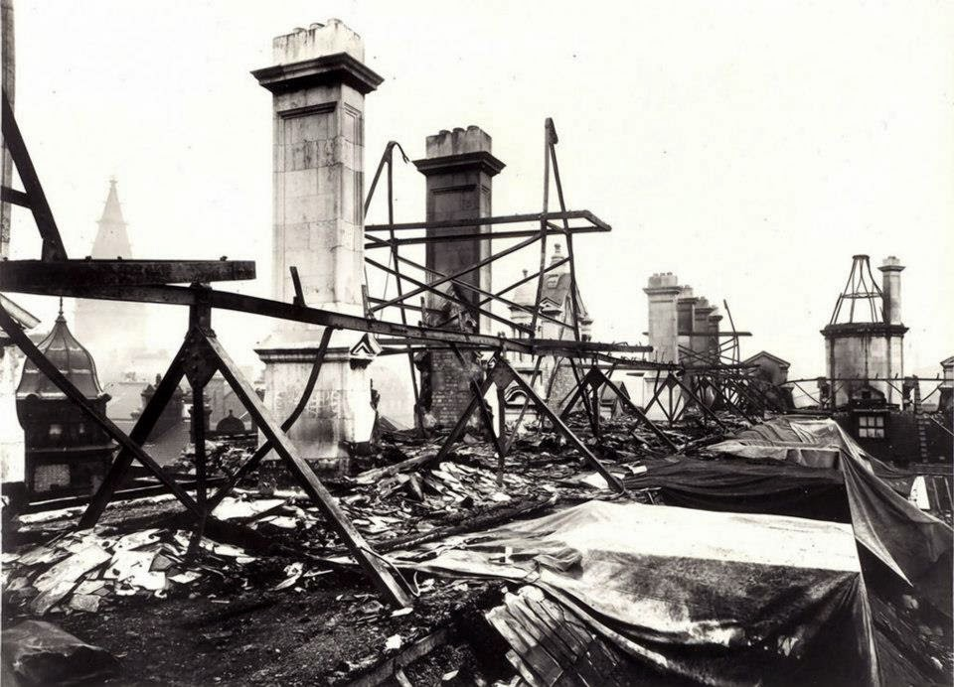

Slide 10
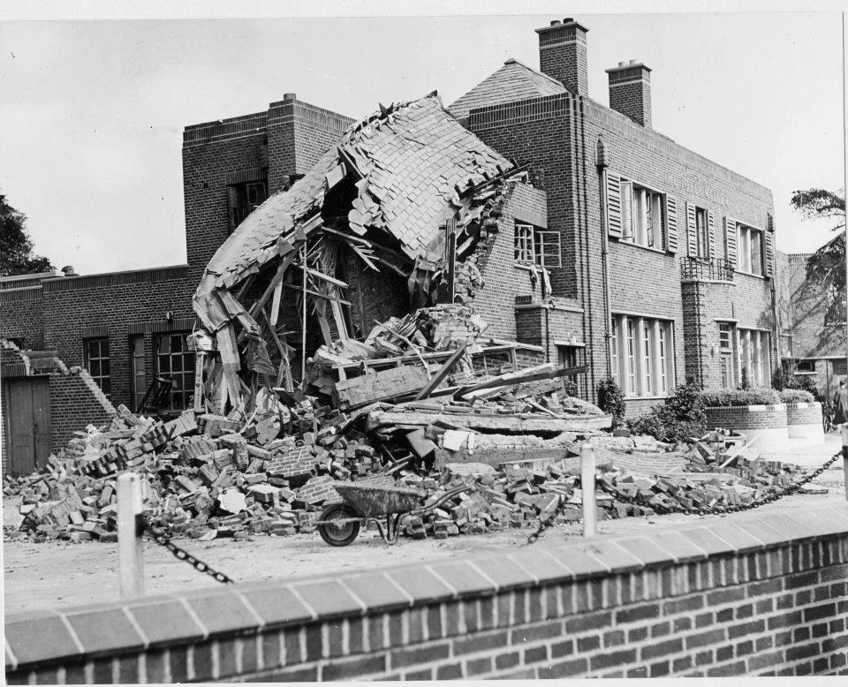

Slide 11
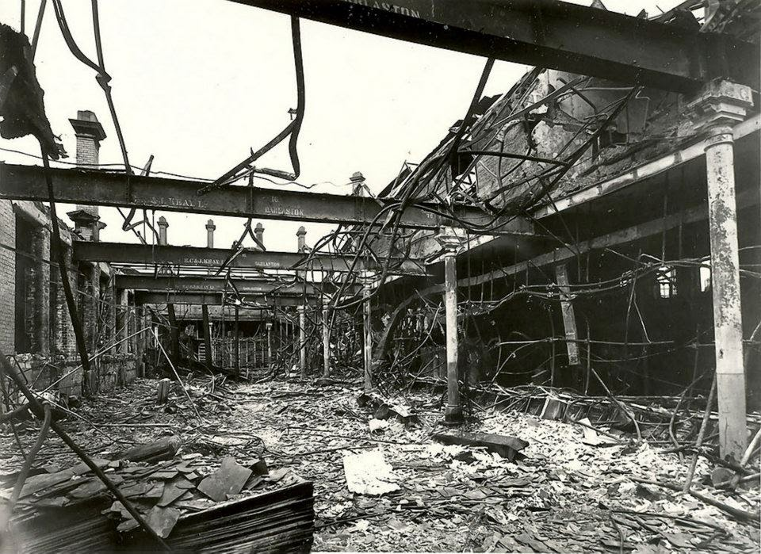

Slide 12
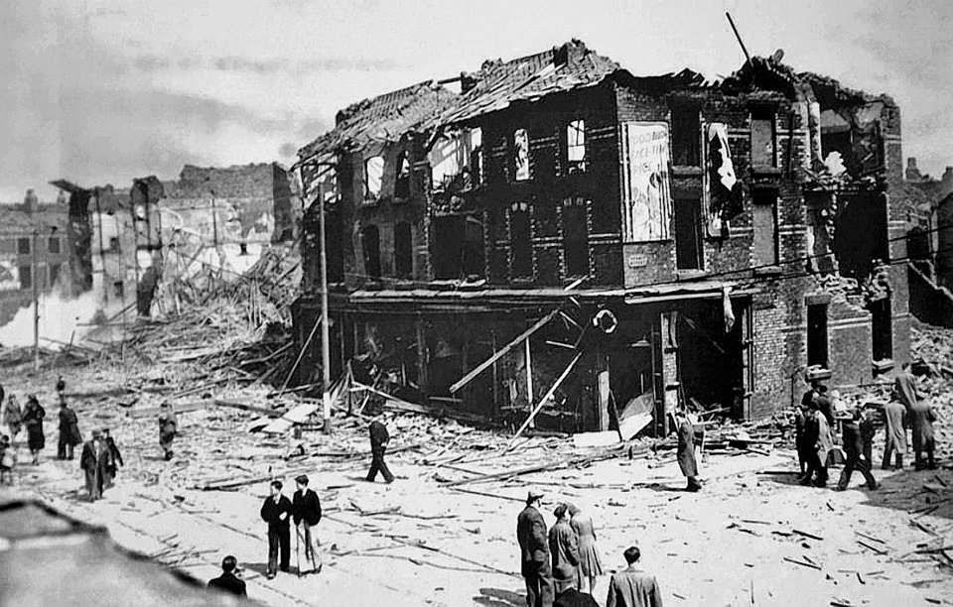

Slide 13
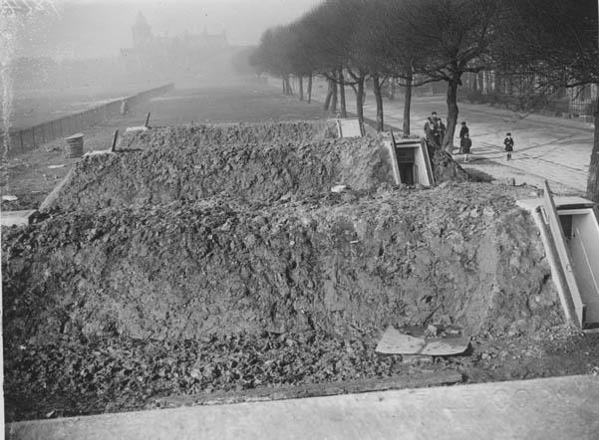

Slide 14
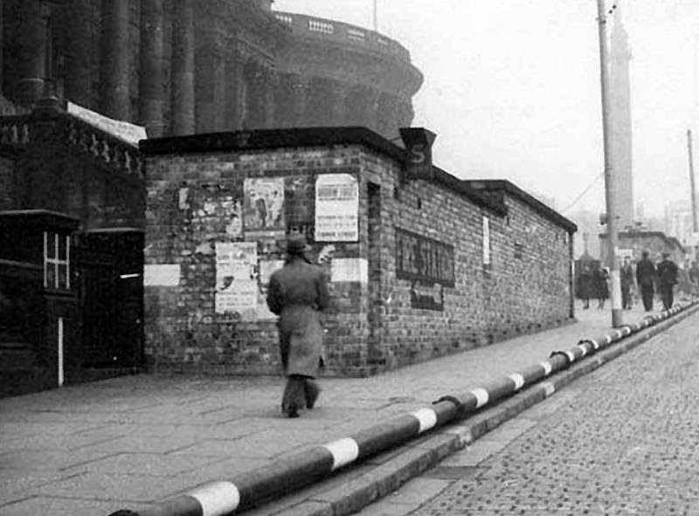

Slide 15
Thousands of children left home for the first time as evacuees. School lessons and exams went on more or less as usual, though children also learned air raid drill and how to put on a gas mask. At night, many children slept in air raid shelters.
There were fewer toys for Christmas or birthdays, and not many sweets either. Many seaside beaches were closed. However, children found new playgrounds on 'bombsites' - waste ground where buildings had been flattened by bombs.
Many families were split up. Fathers, uncles and brothers left home to join the Forces (army, navy or air force). People travelled more, to do war work and to fight overseas. Mothers and older sisters went to work in factories.
There was rationing of food, clothes and other goods. Air raids made it hard to get a good night's sleep. Bomb damage often meant no gas or electricity. Train and bus journeys took longer. Going to school or work often meant walking over bricks and broken glass in the streets. At night, the blackout made towns and cities dark

Slide 16
People expected cities to be bombed, as enemy planes tried to destroy factories. But bombs would hit homes and schools too, so children would be in danger. The government tried at the start of the war to 'empty the cities' of children and mothers, This was 'evacuation', to protect them from air raids.
The plan was put into action in September 1939. About 800,000 children left their homes. However, many returned home after a few weeks. Others stayed in the countryside for the rest of the war.
Children were sent from cities to places where there was less risk of air raids. Many London children went to Devon, Cornwall and Wales. Other children moved to villages in the North, East Anglia and Scotland.
Evacuees went to live with host families. Their new homes were called 'billets'. 'Billeting officers' arranged for people to look after the children. Things did not always go to plan. Some children ended up in the wrong places. Sometimes evacuees just stood in a line, and local people picked which children to take.
A smaller number of children (perhaps 10,000) went to other countries such as Canada, Australia and the United States.

Slide 17
An evacuation journey often began with a walk to school. Then it was off in buses to the station, where special trains were waiting. It was quite exciting, but most children felt sad as they waved goodbye to their mothers and the steam train puffed away.
Every evacuee had a gas mask, food for the journey (such as sandwiches, apples, chocolate) and a small bag for washing things and clothes. Pinned to the children's coats were labels. On the label were each child's name, home address, school and where he or she was going. Often the journey took several hours.
Though evacuees missed their homes, many enjoyed the country. Country life was full of surprises. Some city children had never seen a cow, and were startled to see where milk came from. Seeing carrots growing in muddy fields, one child said in disgust 'ours come in tins'.
Locals and evacuees went to school and played together. Most became friends, though local children sometimes said it was unfair when the 'townies' were given sweets and parties!

Slide 18
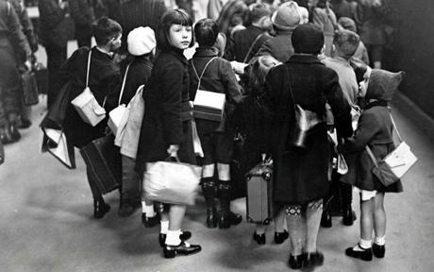

Slide 19
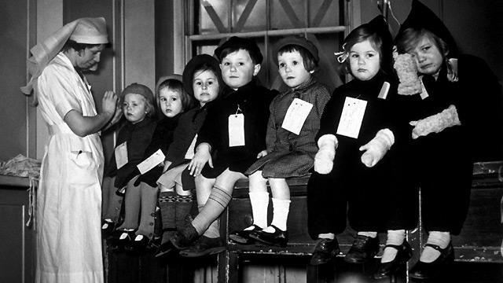

Slide 20
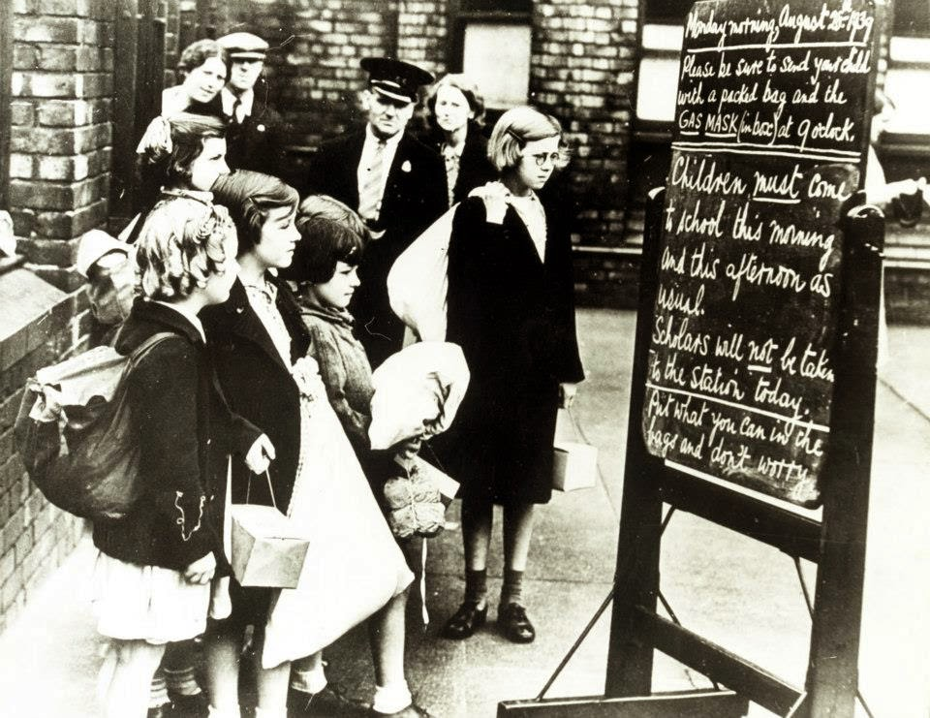

Slide 21
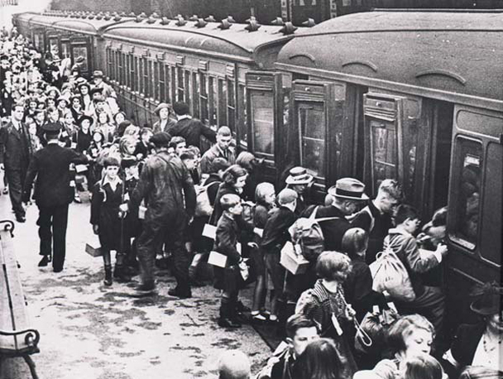

Slide 22
Dear Mum,
Me and Mildred really miss you and Dad. We hope that you are coping well. We’ve arrived at our house in Wales and the family seems nice. And guess what ... They live on a farm!
This place is much better than the last one, where they treated us like servants. They have a daughter called Nancy and she is only a year younger than me so we have become good friends. We pick apples and feed the animals on the farm, and play games like whip and top.
Nancy couldn’t believe it when I told her about the air raids. She said the bombs would have made her go insane. I told her abut my friend Ann, who died wit her family, and Nancy was so sad that she cried.
I wish you could let me know what is happening, but I know you’re not allowed to say much in your letters. I can’t wait to come home and see everybody. Please stay safe and give dad a kiss from both of us.
Lots of love
Christiana and Mildred

