Slide 1
Home Learning Challenges
It’s a shame we missed out on our residential this year, instead you can take part in your very own adventure week at home. These challenges are optional and intended to be a bit different to a normal home learning routine.
You may need some help from an adult with some of the challenges and make sure you check with an adult first if you can do them all.
Maybe try one each day and remember to take some photos of you doing them so we can share them on the school website! ☺

Slide 2
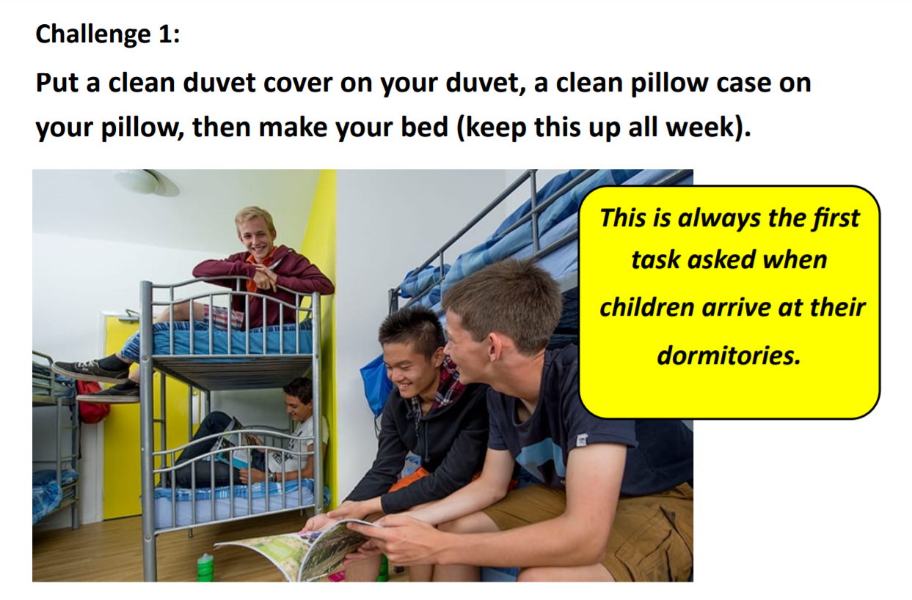

Slide 3
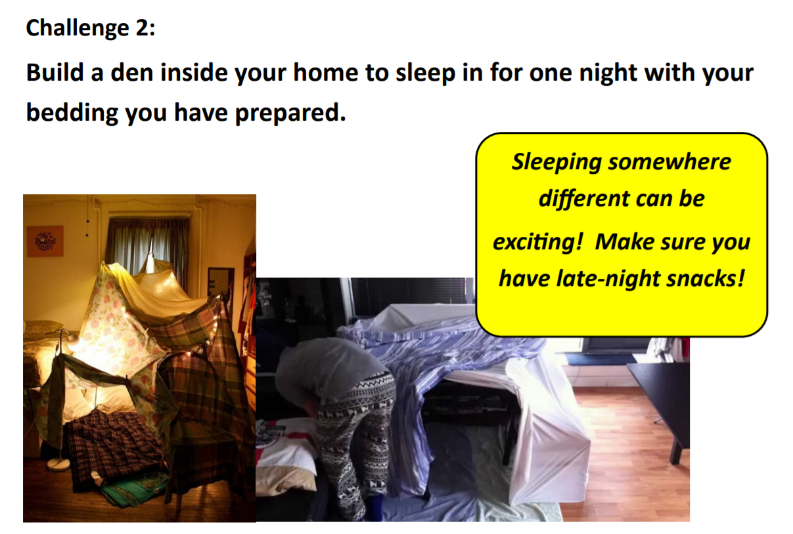

Slide 4
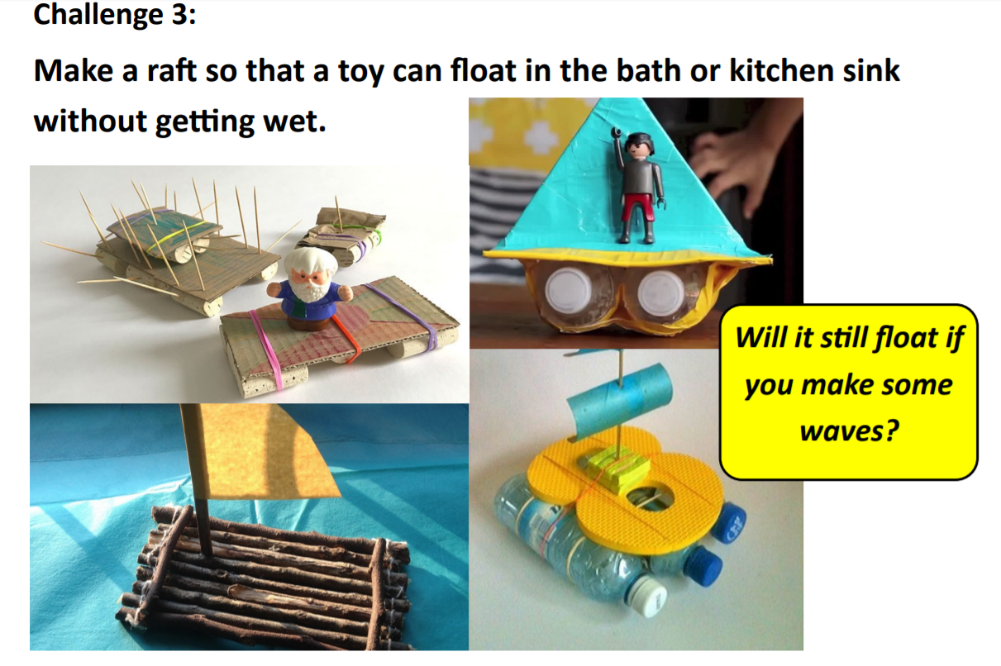

Slide 5
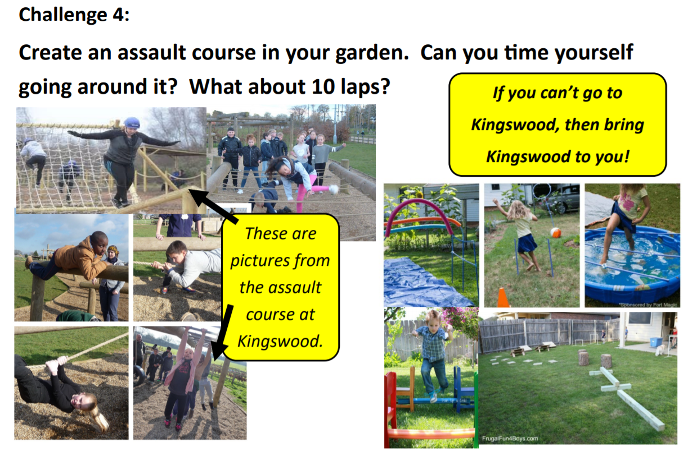

Slide 6
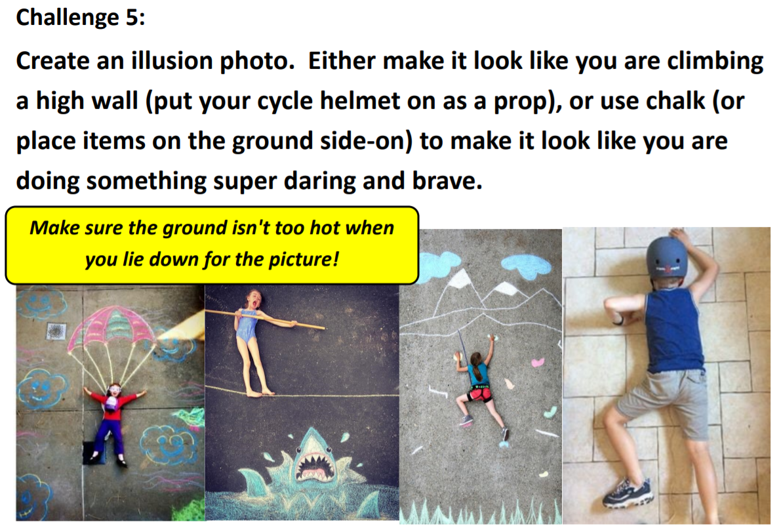

Slide 7


