Slide 1
African Artwork

Slide 2
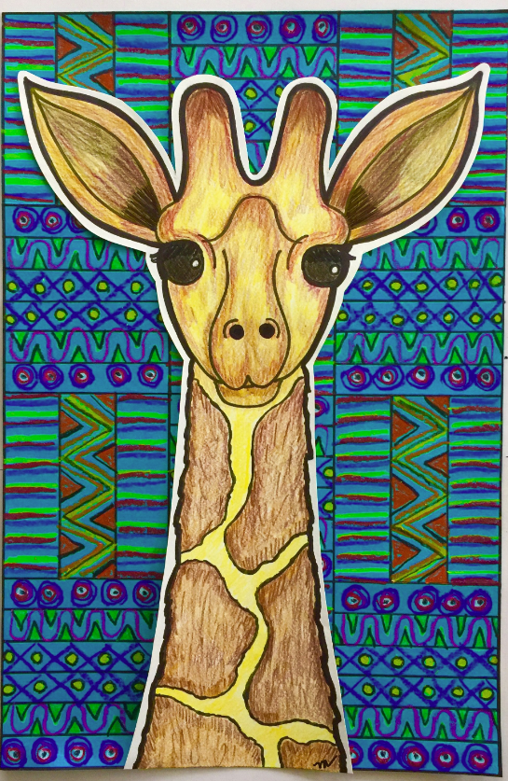

Slide 3


Background Patterns

Slide 4


Slide 5


Slide 6
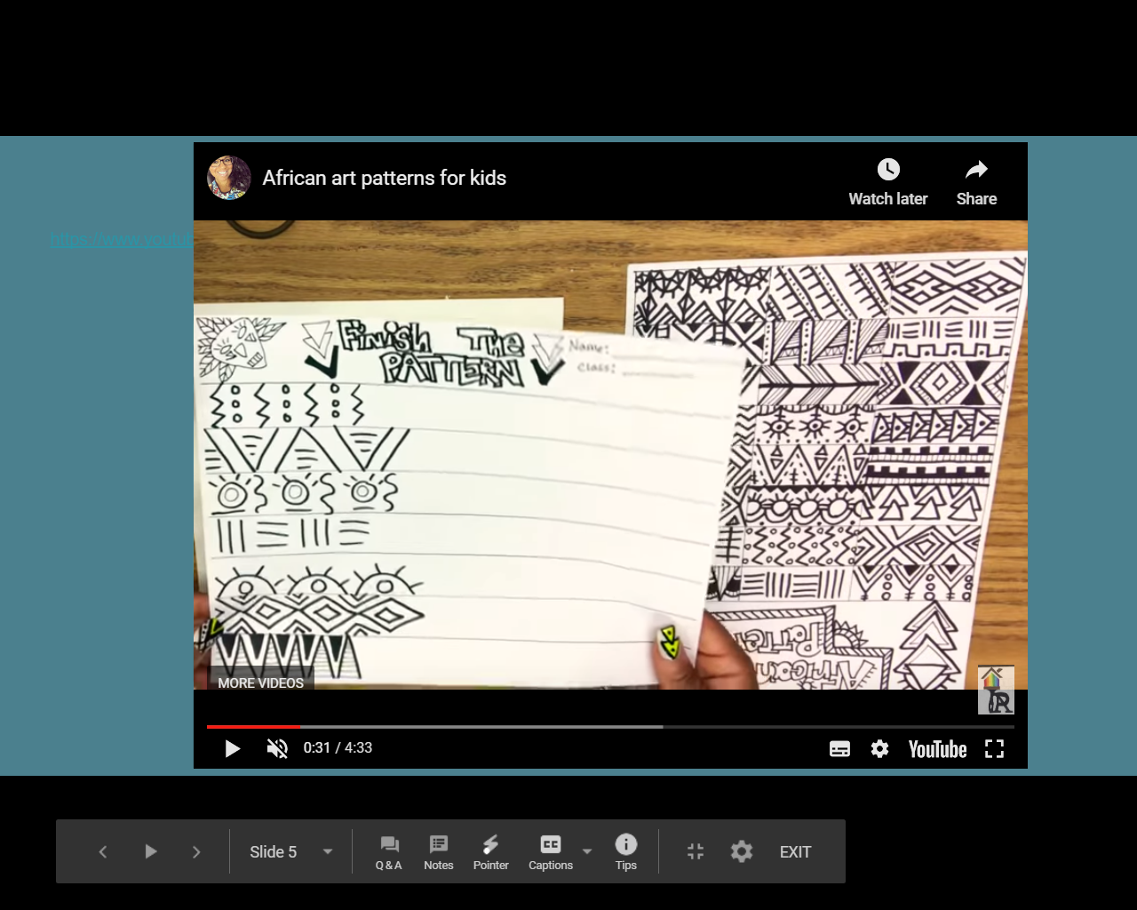
Step 1
Practice some patterns step by step by finishing the pattern:

Slide 7
Step 2
Create your own patterns

Slide 8
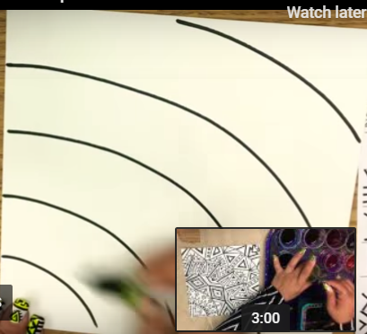
Step 3
Create your background template to draw your patterns on.

Slide 9


