Slide 1
I have a dream

Slide 2
Tuesday 9th June 2020
The Louisiana Literacy test:
You have 10 minutes to complete this test.
Any incorrect answers results in failure of the test.
*NOT a scary test*, don’t worry, but we need to complete this to understand the rest of the lesson. It will become clear ☺

Slide 3
How did you feel about the test?
The Louisiana Literacy Test had no standard answer key. The individual white registrars determined what the “correct” answers were. If you didn't get any of these questions right the very first time, you would not have passed.
Is this a fair test?
How might people have felt if they actually had to take this test?

Slide 4
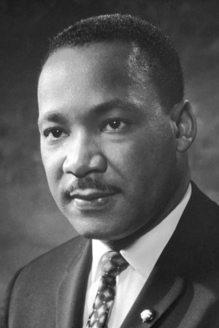
Who is this man?
What is he known for?
Why might we be learning about him today?
Martin Luther King Jr. (born Michael King Jr.; January 15, 1929 – April 4, 1968) was an American Christian minister and activist who became the most visible spokesperson and leader in the Civil Rights Movement from 1955 until his assassination in 1968.
King is best known for advancing civil rights through non-violence, inspired by his Christian beliefs and the nonviolent activism of Mahatma Gandhi.
Let’s watch this video to see if you were right and find out more about him…
https://www.youtube.com/watch?v=vP4iY1TtS3s

Slide 5
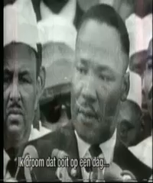
‘I have a dream’
What did you notice about the way he spoke?
Discuss the message - What was he talking about?
What was his vision for the future?
Has this happened?

Slide 6
What is figurative language?
Recap similes, metaphors, alliteration and personification. What are they? Can you give me an example?
I have a dream that one day
this world can live in harmony.
And that the youth of today will access an education.
Read through the example stanza.
Is this powerful enough? Does it inspire you?
How could we improve it? How can we add figurative language for effect?
Does it need to rhyme to be a poem?

Slide 7
What are your dreams for our future world?
Discuss – what are some current issues that you could include?
Plan the figurative language that you are going to use in your poem. What is the message you’d like to portray? How can you inspire others with your words?
Share good examples of the various different types of figurative language that you have used – what are you proud of?

Slide 8
Wednesday 3rd June 2020
How does MLK describe the future nation he wants his children to live in?
What is the message of this passage?
How has MLK used language/techniques to make his speech memorable and persuasive?
I have a dream that my four little children will one day live in a nation where they will not be judged by the colour of their skin but by the content of their character. I have a dream ... I have a dream that one day in Alabama, with its vicious racists, that one day right here in Alabama, little black boys and black girls will be able to join hands with little white boys and white girls as sisters and brothers.

Slide 9
Can we write a model stanza together?
What are your dreams for our future world?
Think about how you will structure your poem e.g. will you include repetition? Will you include same number of lines, how do you want it to read?
Start to write – think really carefully about your language choices. Every word Martin Luther King chose and expressed in his speech was there for a reason.

Slide 10
Thursday 4th June 2020
Love of Reading
The Boy, the Mole the Fox and the Horse.
Create your own Charlie Mackesy inspired art work with a quote/short conversation

Slide 11
Thursday 4th June 2020
Continue to write poems and edit as you go

Slide 12
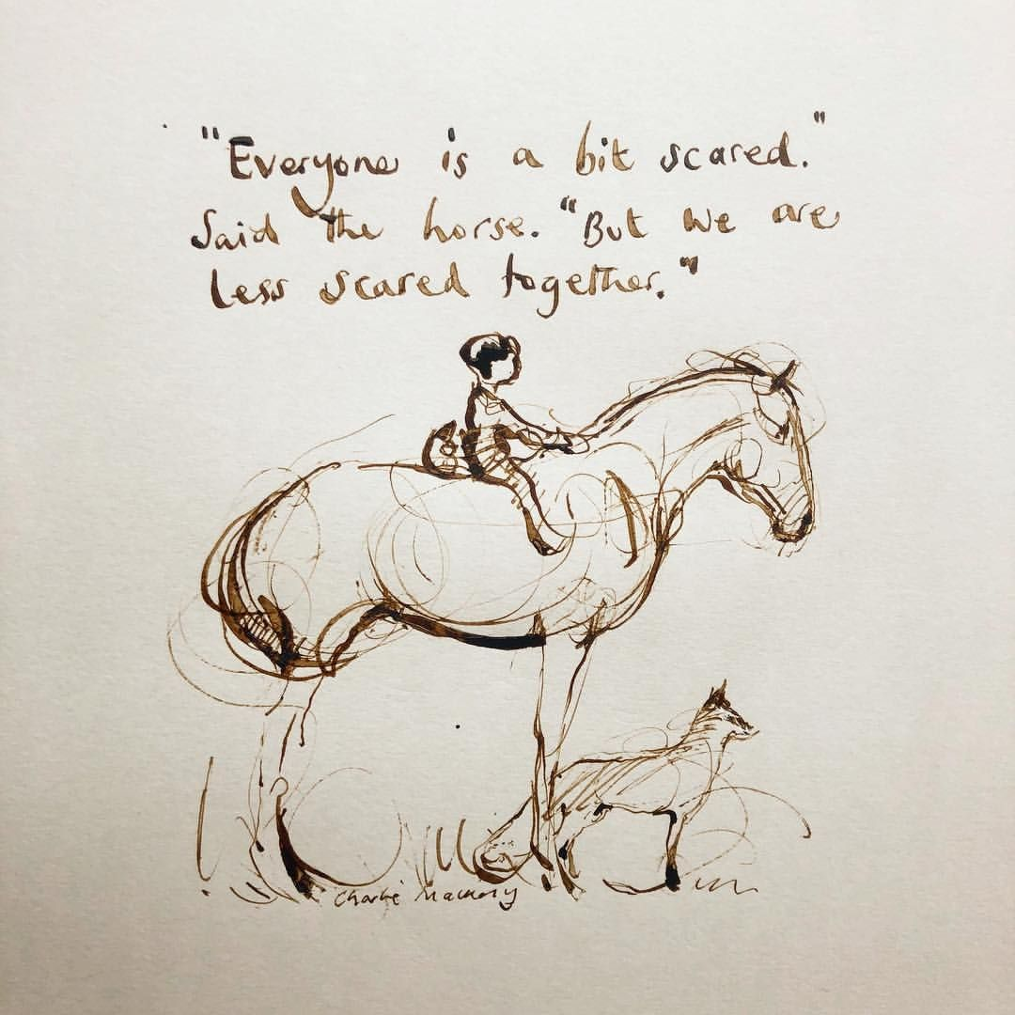
Friday 5th June 2020
Do you agree with the horse?
Think about a time when you have been scared.
How did you overcome that fear?
Did anyone help you?
Are you scared of anything now?
How could you conquer this fear?

Slide 13
Continue to write poems and edit as you go
Perform poems to the rest of the bubble

