Slide 1
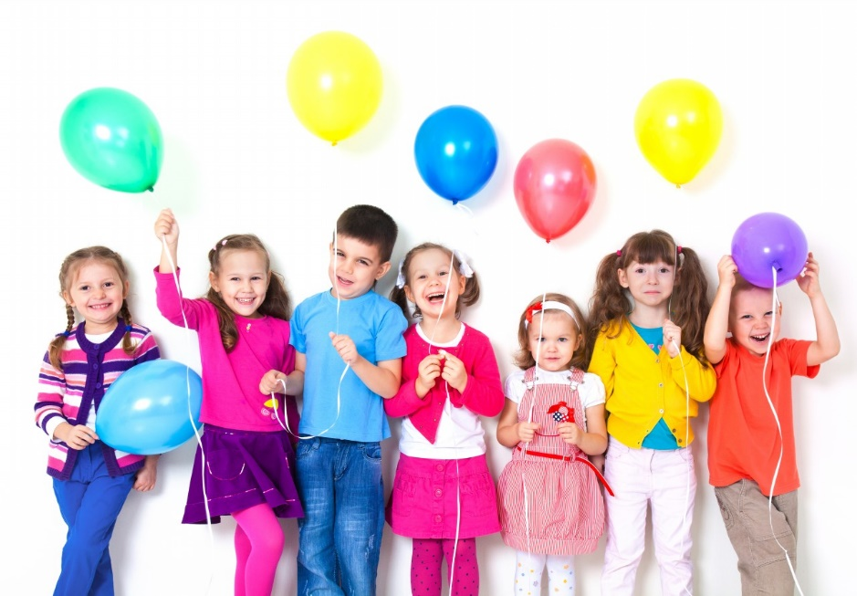
Promoting Good Mental Health and Well-being
Here are some simple ideas and resources we use in school to support children of all ages.
They are to do with relaxation, positivity, mindfulness, promoting happiness and being thankful for what we have.
We hope they are of value to you at home too.

Slide 2
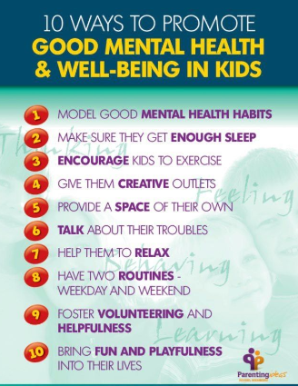
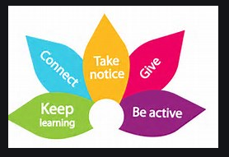

Slide 3
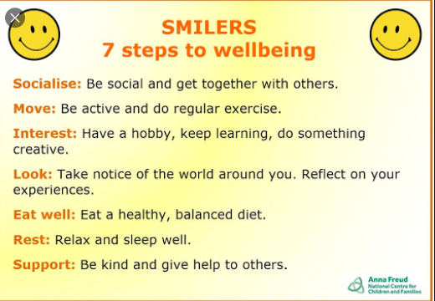

Slide 4
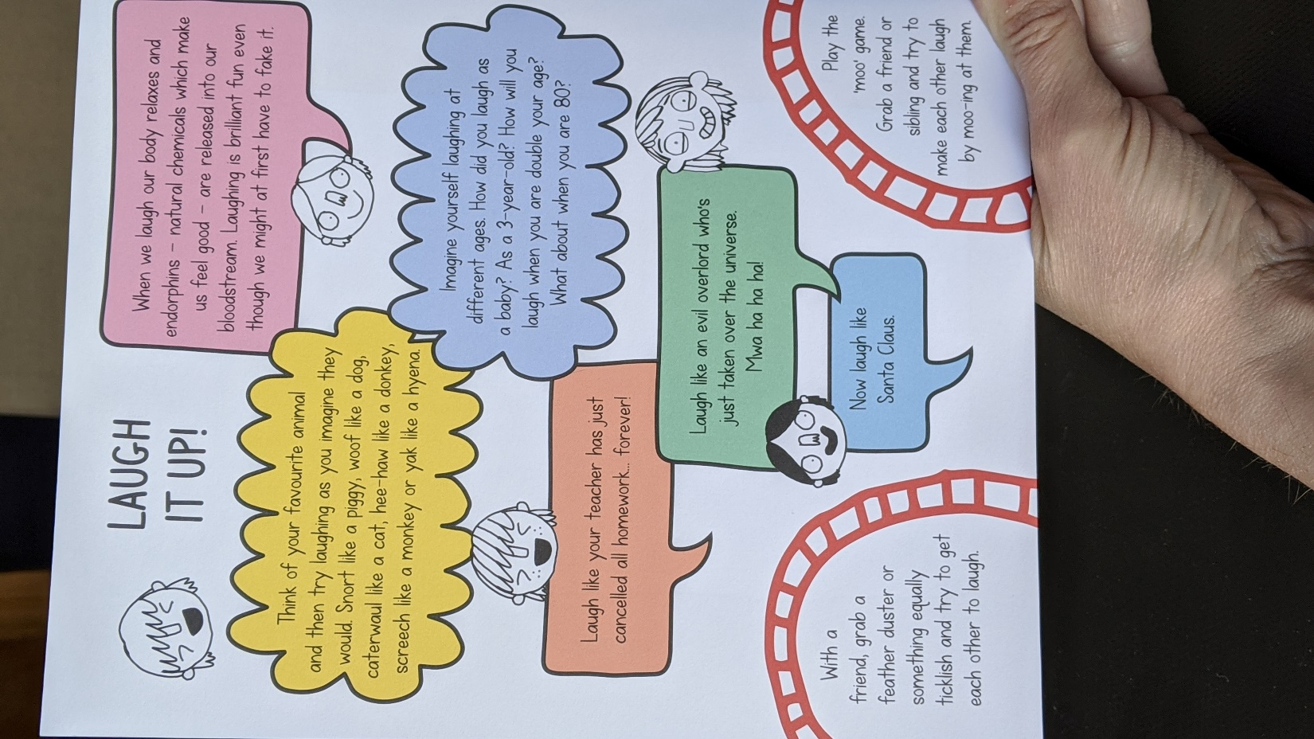

Slide 5
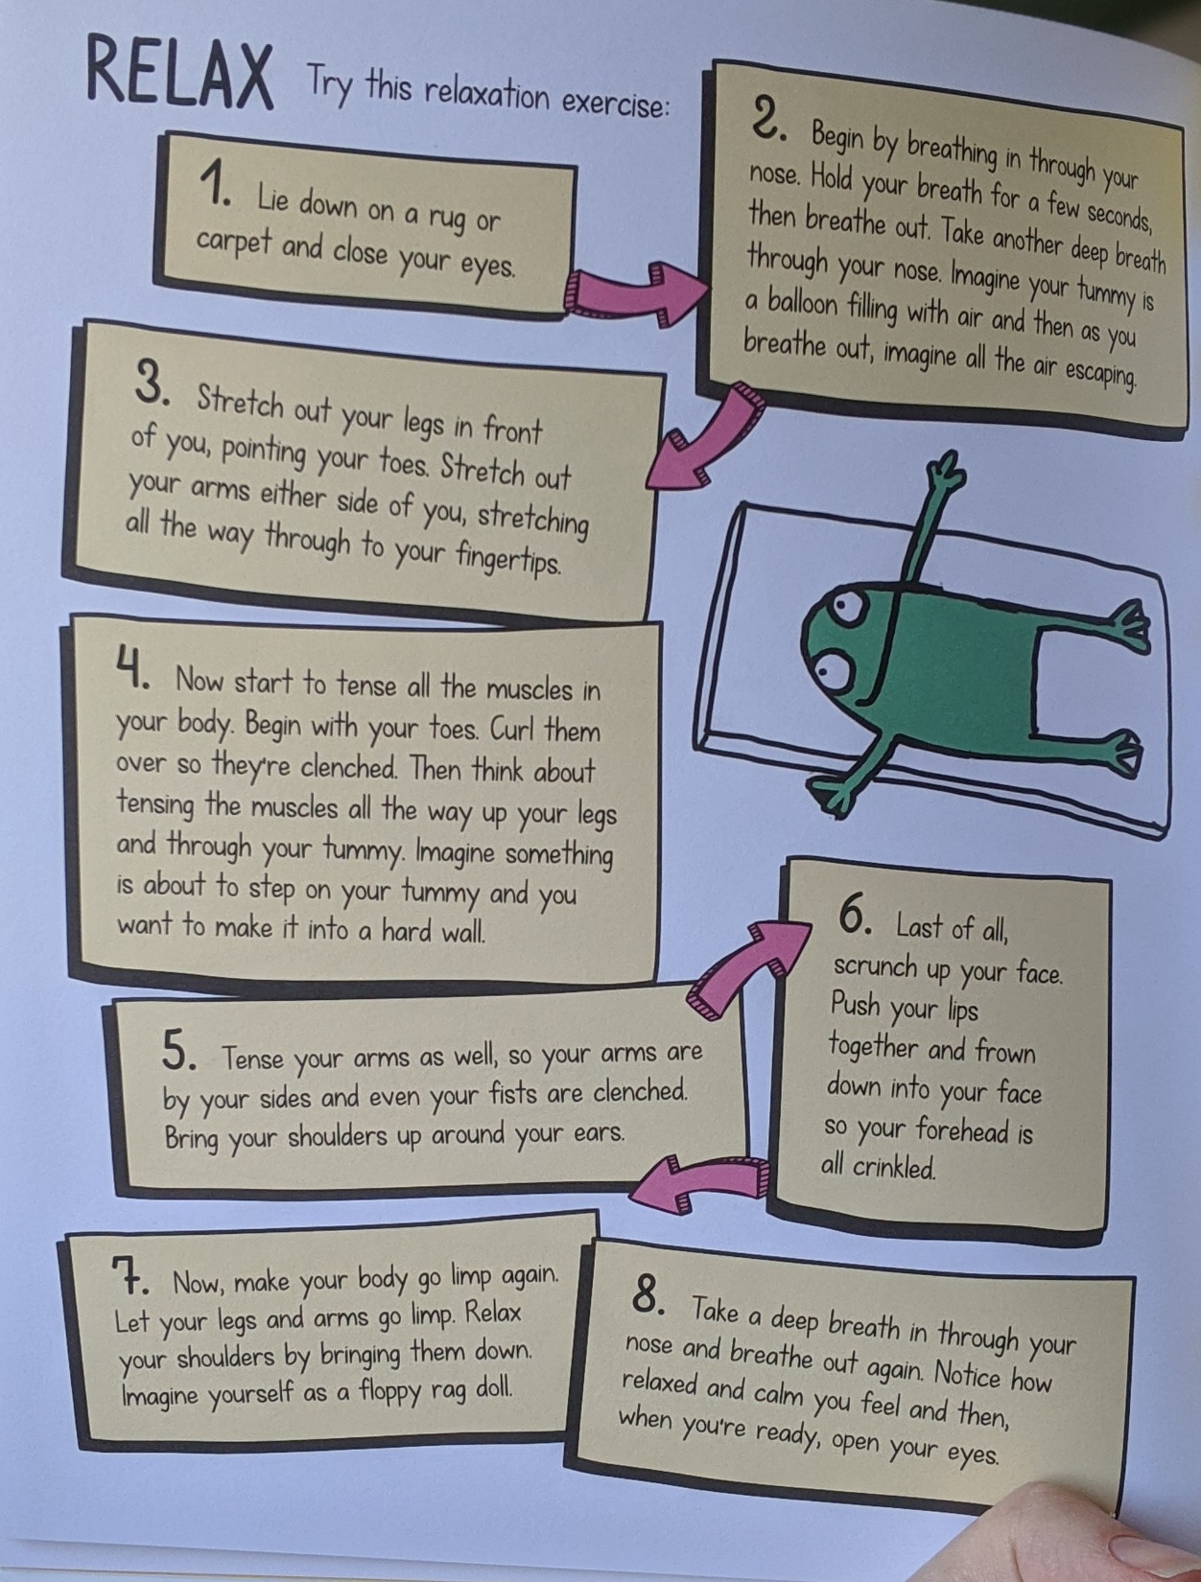

Slide 6
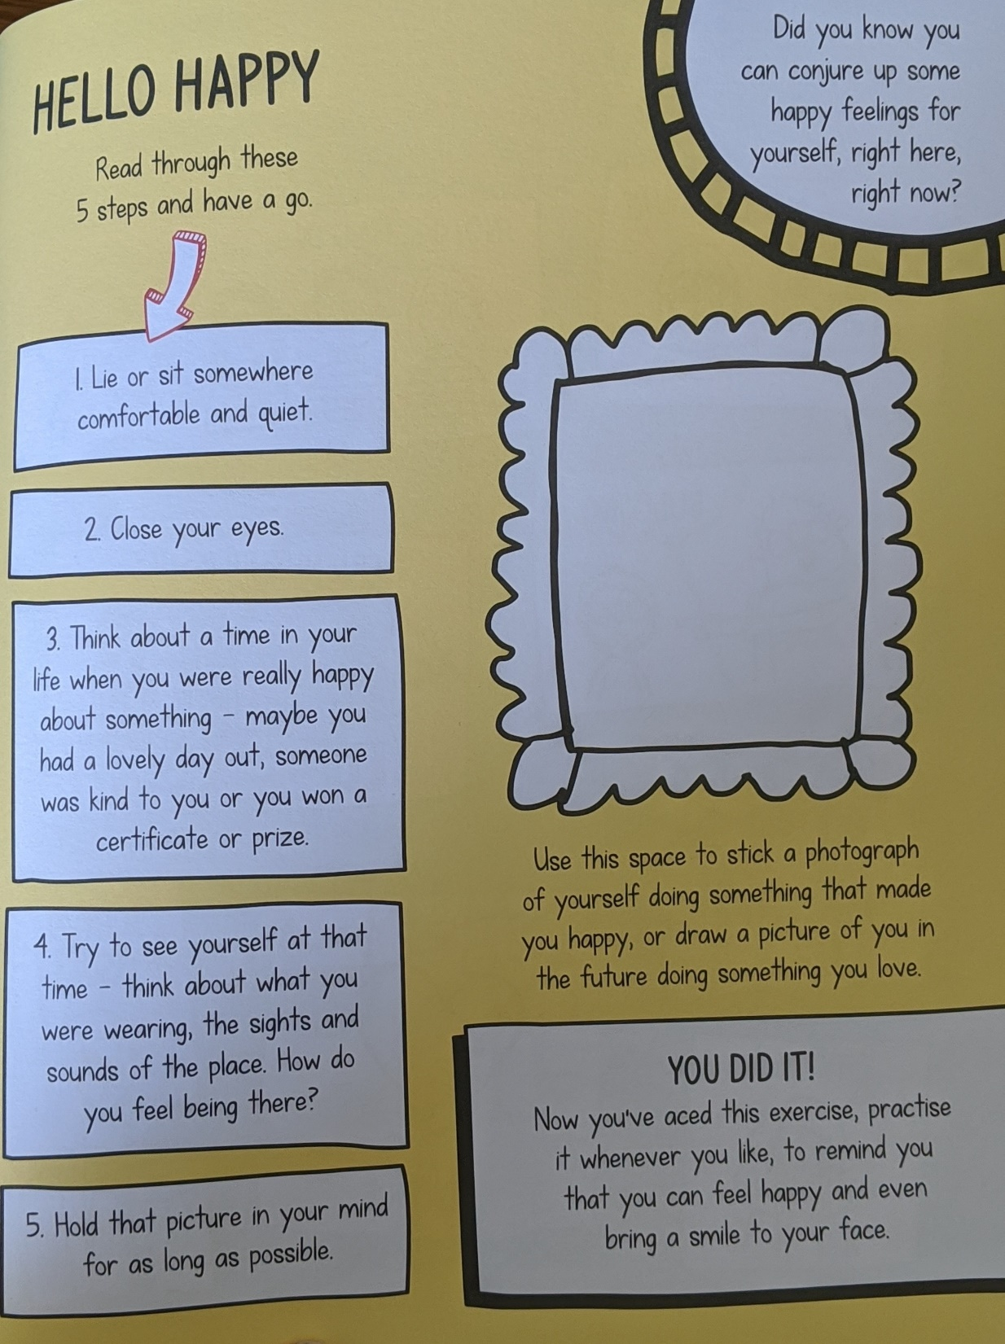

Slide 7
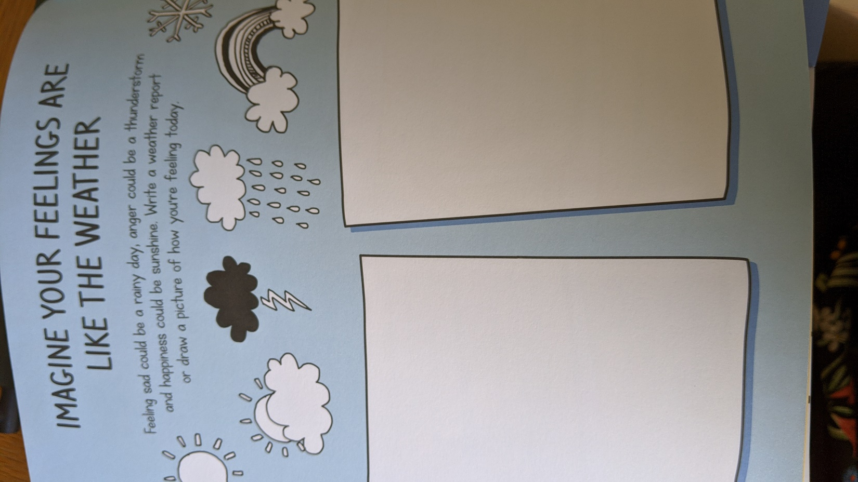

Slide 8
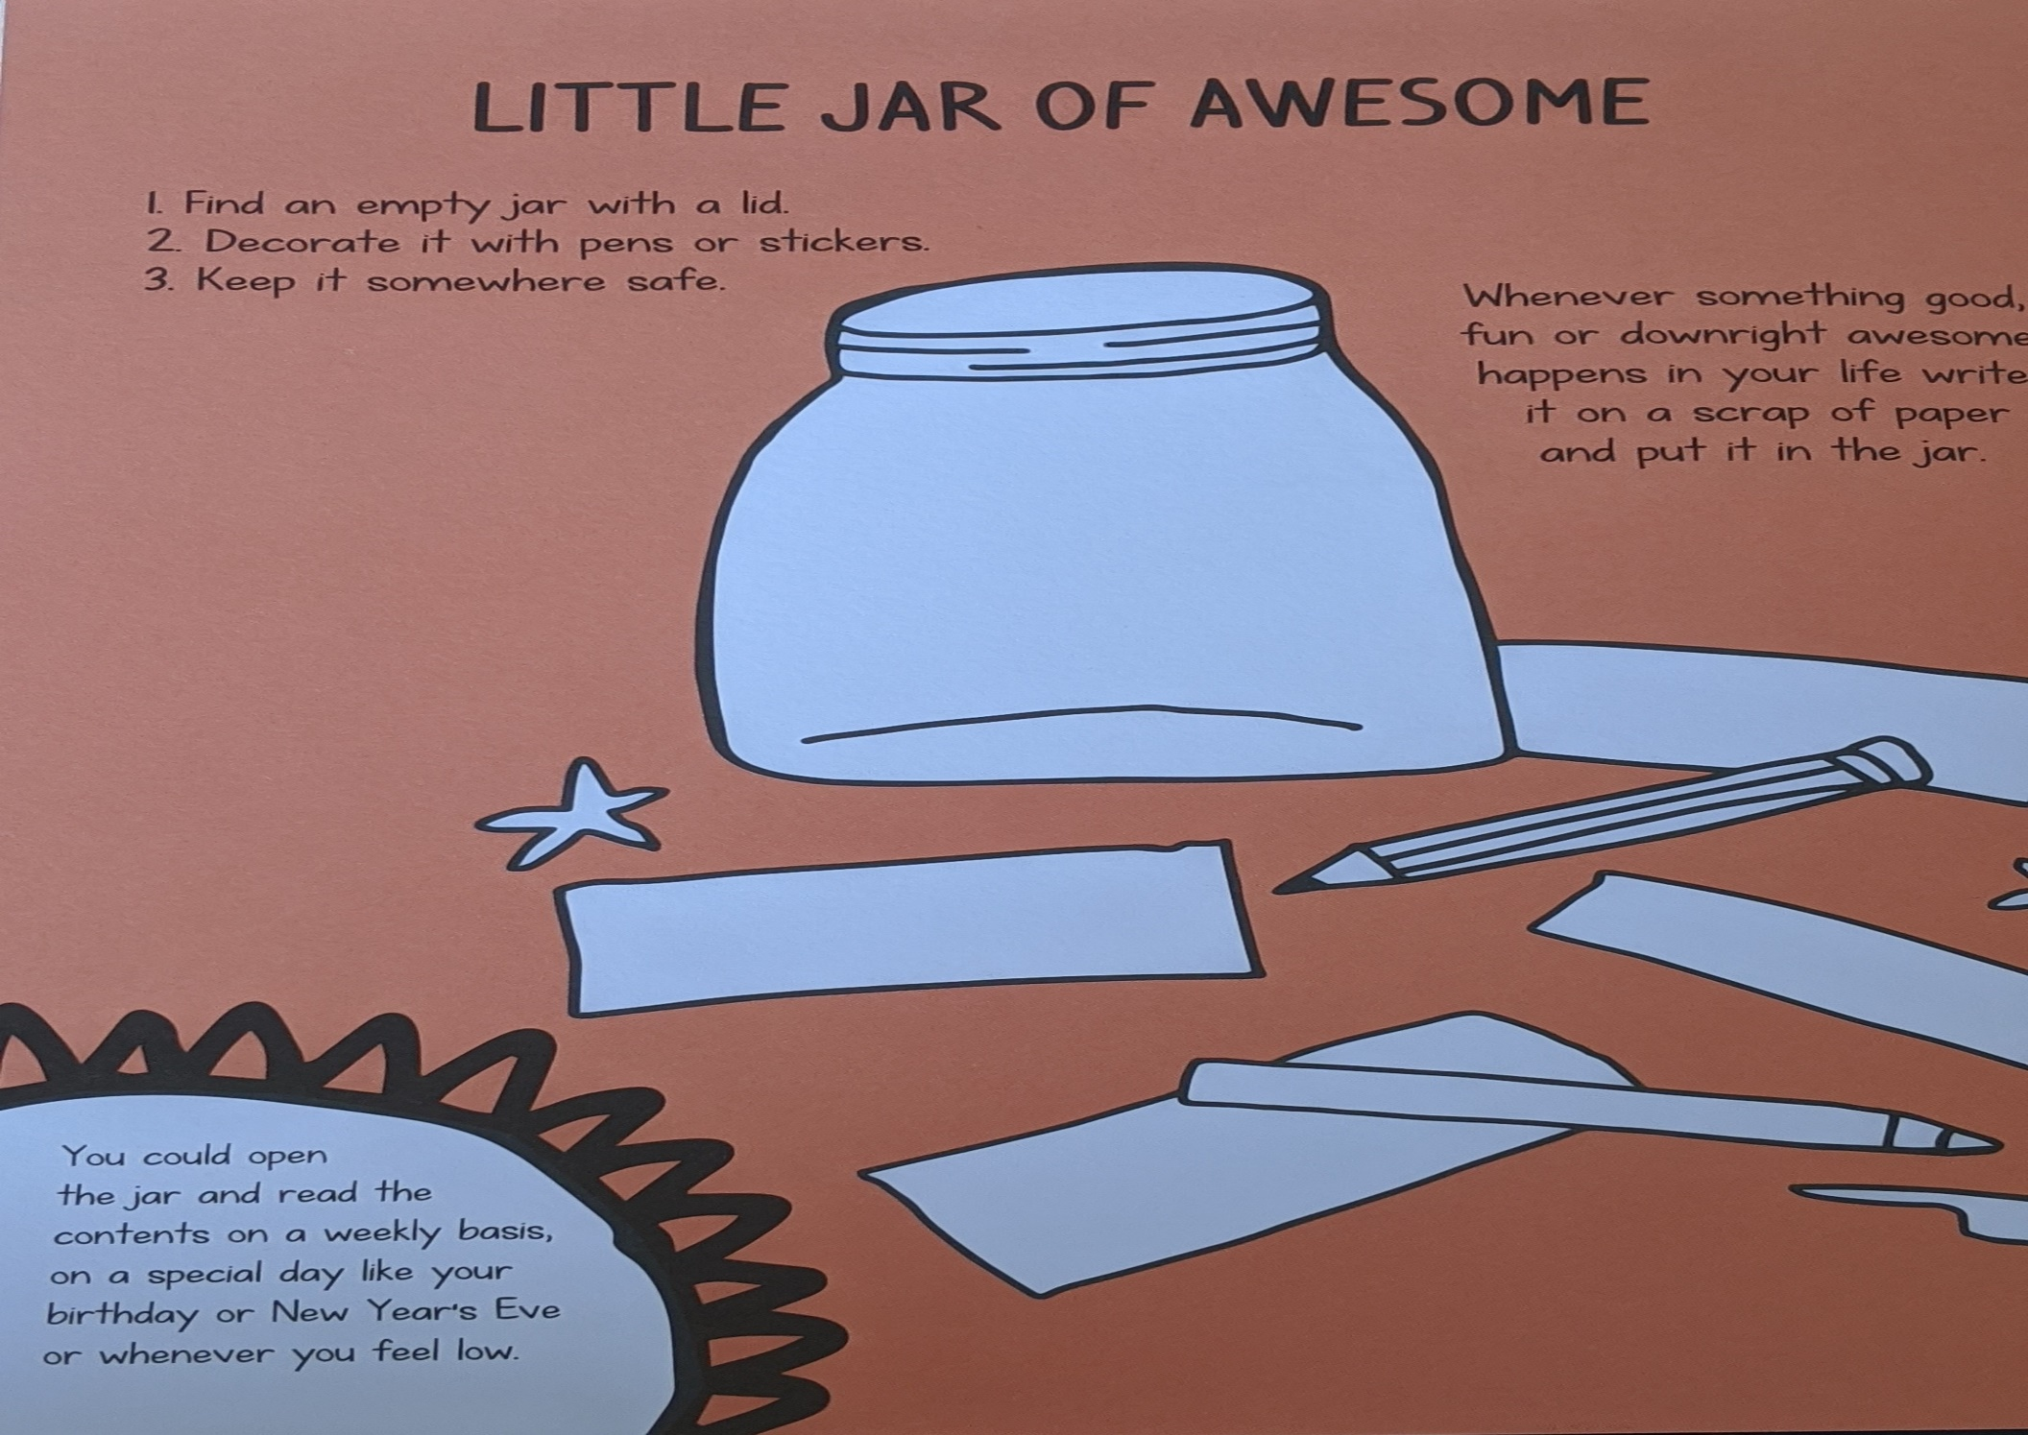

Slide 9
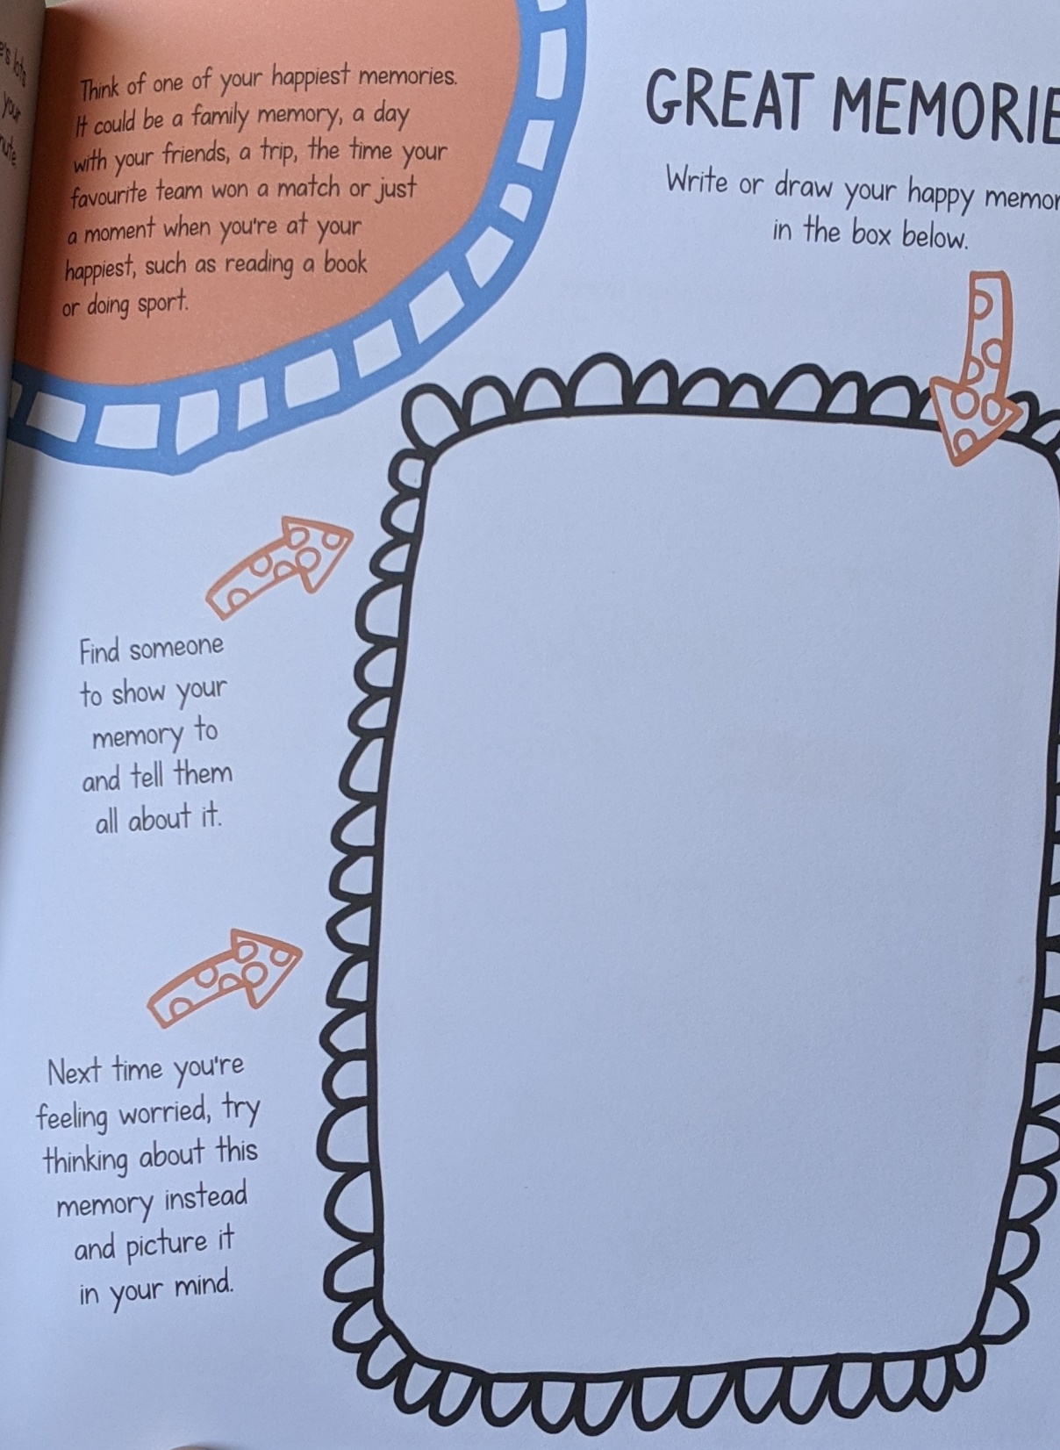

Slide 10
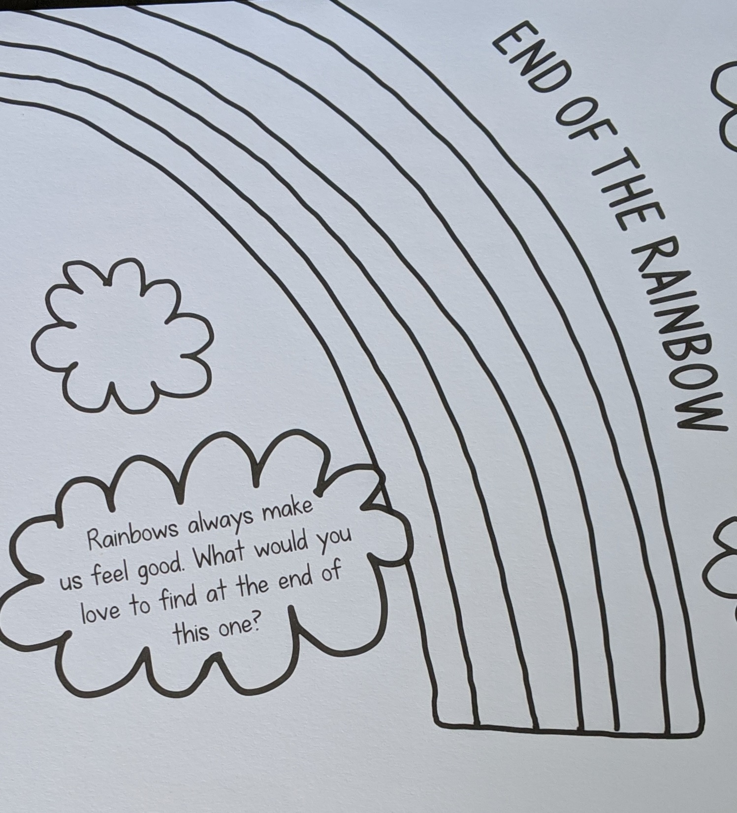

Slide 11
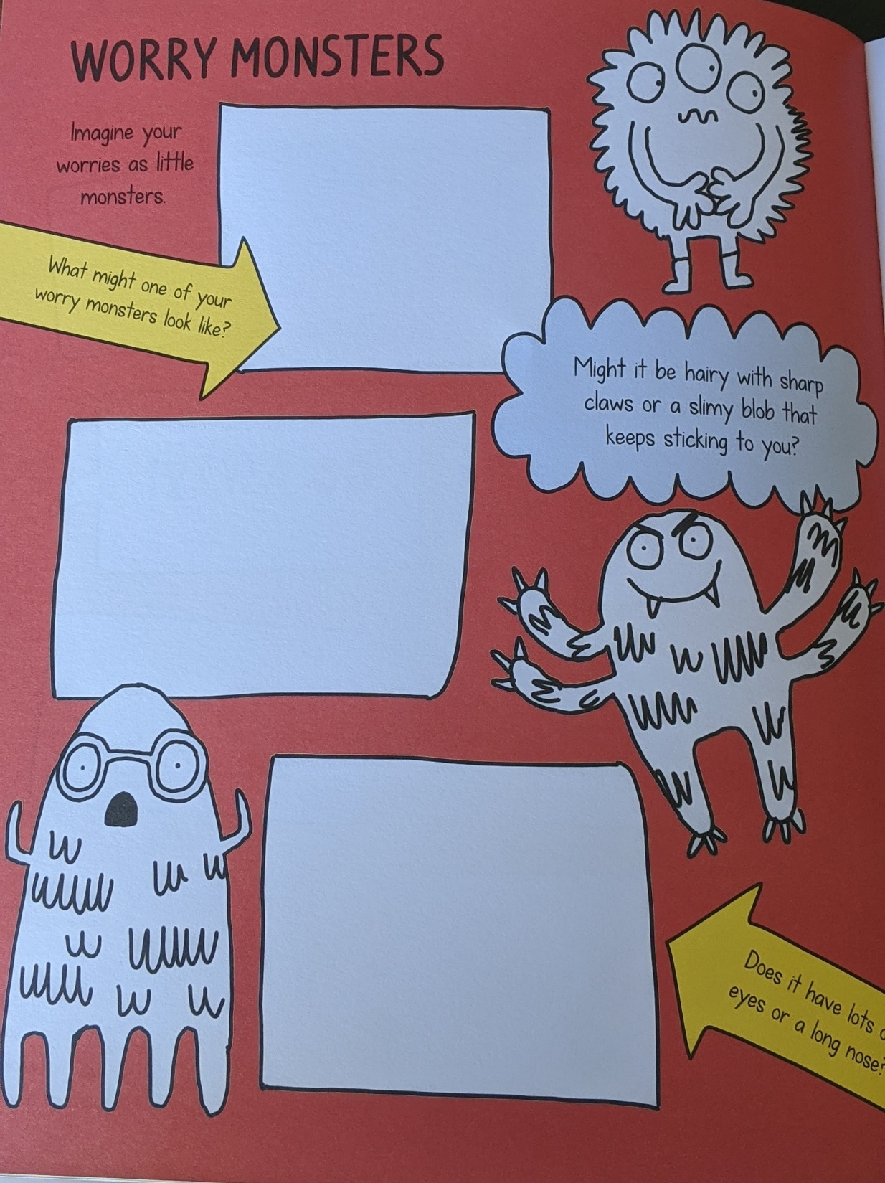

Slide 12
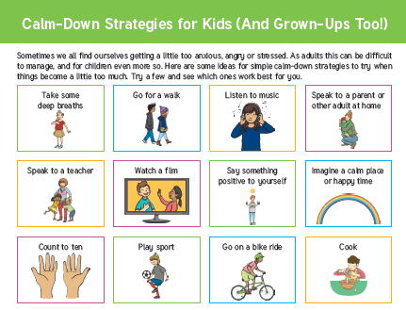

Slide 13
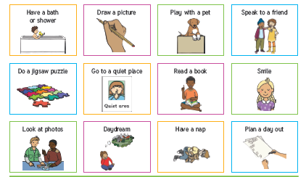
More calm-down strategies…choose the ones that feel right for you. Everyone is different!

Slide 14
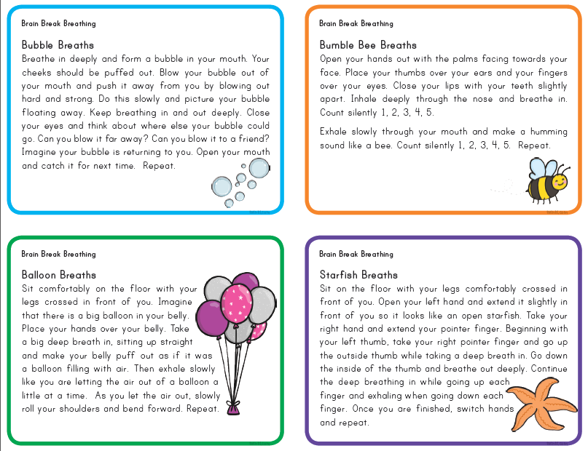
Breathing
Using the breath is a powerful way to calm and control our emotions.
Practise these breathing exercises daily …it takes a while to get the hang of, but is a fantastic tool in your toolkit of wellbeing.

Slide 15
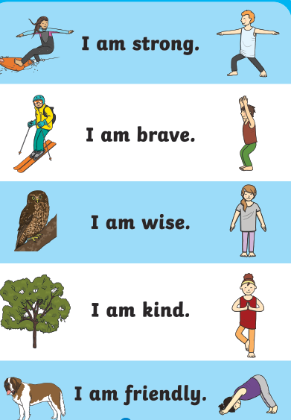
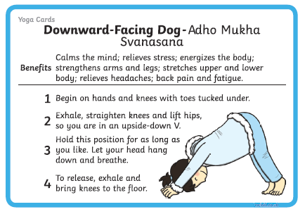
Try some Yoga!
Here are 5 simple yoga poses to do to help build positivity, strength and inner peace.

Slide 16
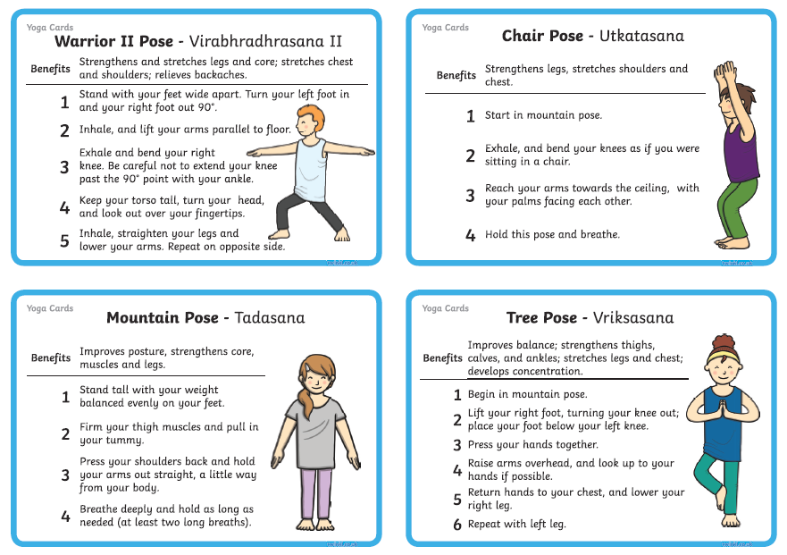

Slide 17
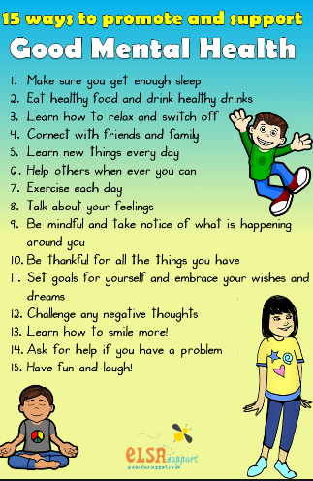
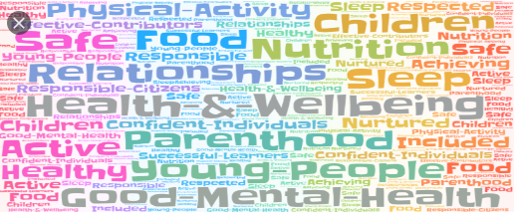

Slide 18
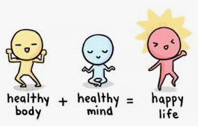

Here are just a few of the many websites that offer guidance and support on mental health, safety and well-being for children and parents.
www.schoolwellbeing.co.uk
www.annafreud.org
www.childline.org.uk
www.actionforchildren.org.uk
www.nhs.uk/oneyou/every-mind-matters
You can access educational resources on rail safety via
https://www.networkrail.co.uk/communities/safety-in-the-community#
For younger children Network Rail created our ‘Stay safe with Thomas’ story book which you can download for free on www.networkrail.co.uk/Thomas

Slide 19
The PE section on the BBC Bitesize website includes a weekly mental well-being activity for children.
Just copy the link to access:
KS1 (Years 1 & 2)
https://www.bbc.co.uk/bitesize/subjects/z2hs34j
KS2 (Years 3-6)
https://www.bbc.co.uk/bitesize/subjects/zj6pyrd
Mindfulness and Well-being Books:
Dr Sharie Coombes is the author of many mindfulness, mental health and well-being books for primary-age children, e.g. ‘Hello Happy’ and ‘No worries’.

Slide 20
Parents’ and Children’s Wellbeing
https://www.bbc.co.uk/teach/supermovers
This is also another great exercise/learning tool that we use in school
https://www.gonoodle.com/
They also have a free APP on Playstore to download with daily exercises
https://www.stopbreathethink.com/kids/
Free, asks the children how they are feeling. There is also an adults’ version which plays music according to how you are feeling and gives you different activities and suggestions to do to lift your mood.

Slide 21
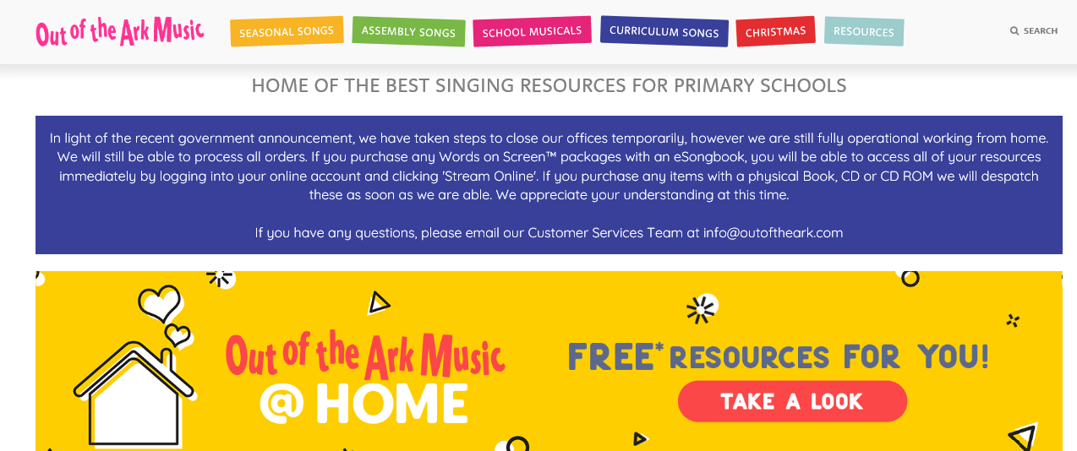
Music, Dance and Well-being
Many of our school assembly songs are taken from this website. They cover themes such as thankfulness, peace, resilience, celebrating difference, conflict and resolution, etc. There are lots of fun music, dance and home learning resources to explore on www.outoftheark.co.uk.

