Slide 1
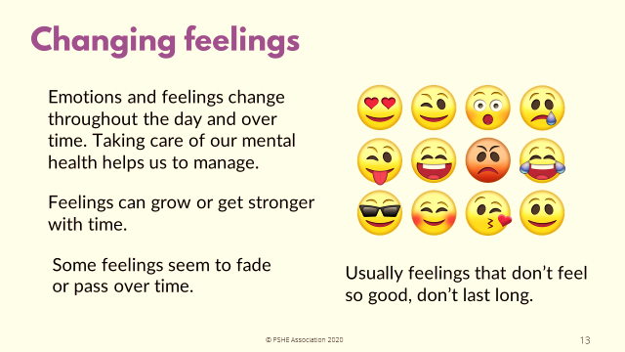
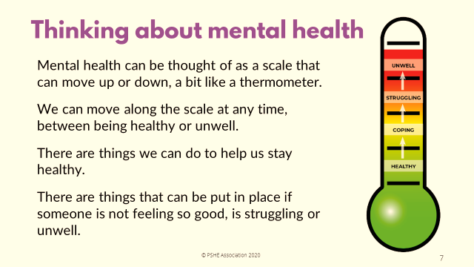
How are you feeling?

Slide 2
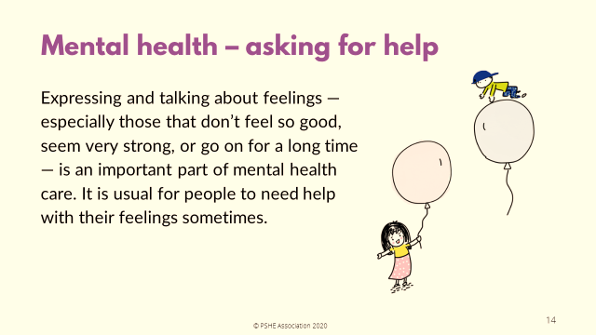
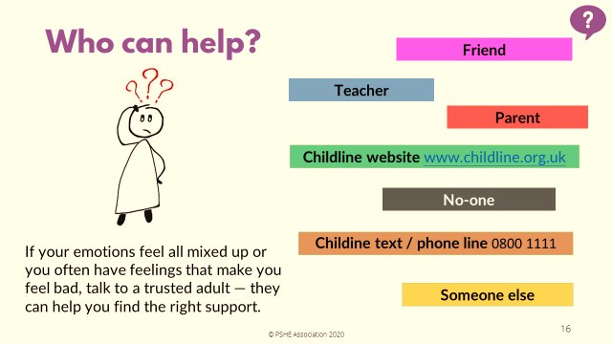
How are you feeling?
What else can YOU do to help YOU?
Activity sheet of ideas from home learning 04.05.2020

Slide 3
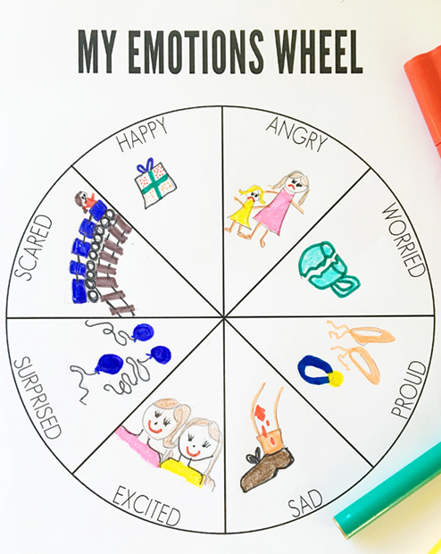
PSHE
Let’s think about our emotions this week.
Create your own emotions wheel, using the emotions like the template:
Draw your own image to represent the emotion.

Slide 4

PSHE
I can identify the most significant people to be in my life so far
I understand how it feels to have people in my life that are special to me
Think about someone who is special to you, they don’t need to say who it is, just to think: choose someone in your family, a special friend, someone you see a lot who is special to you or someone that maybe you don’t see anymore - whoever is special to you.)
This should be a thoughtful, reflective activity to visualise and think about the people who are the most special to in your life.
Repeat 3-4 more times thinking of a new person each time.
Add the people to show how close they are to you using the diagram (the most important people to you would be in the inner
circles, the least important would be on the outer circles.
Me

Slide 5
PSHE
The Colour Monster
https://www.youtube.com/watch?v=Ih0iu80u04Y

Slide 6
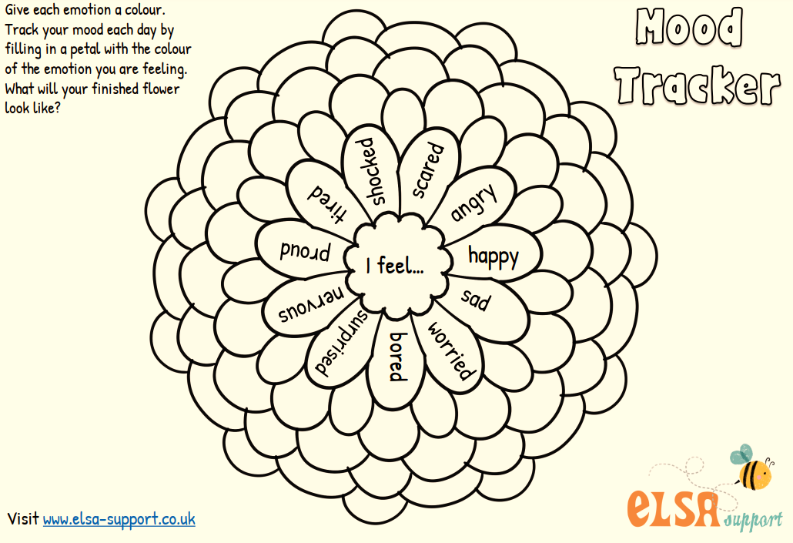
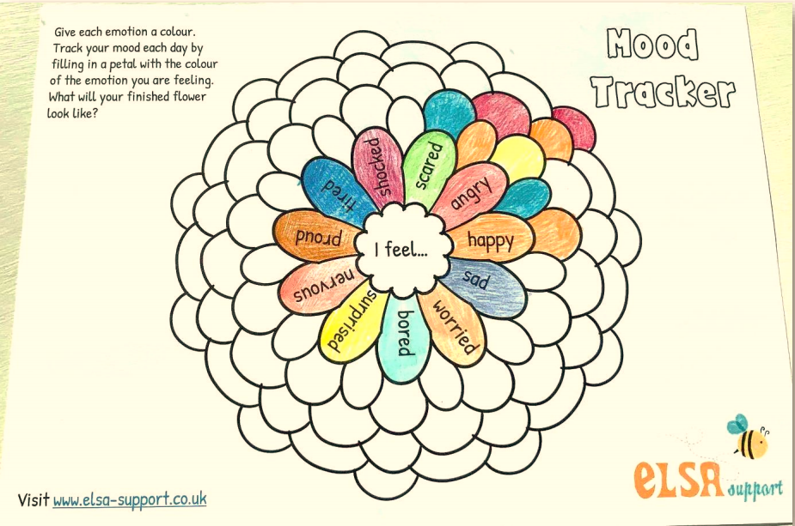
PSHE
Create your own Mood Tracker mandala, using the template and emotion words. Add Tier 2 synonyms for the emotions in the outer sections to build a vocabulary bank of emotion words. Colour the petals to show represent the emotion to you.

Slide 7
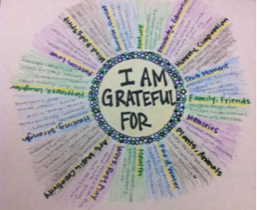
PSHE
During such unusual times, we should appreciate what we have that others’ may not have. Even in times of sadness and worry we can still recognise that we also have a lot to be thankful for. Reflect on this idea…
What are you grateful for? Create a ‘grateful wheel’ like the model. Choose colours to reflect your emotions towards each statement, using our learning about emotions and colour connections from last week.

